Slide 1
Cartoonist Ricardo Caté

Slide 4
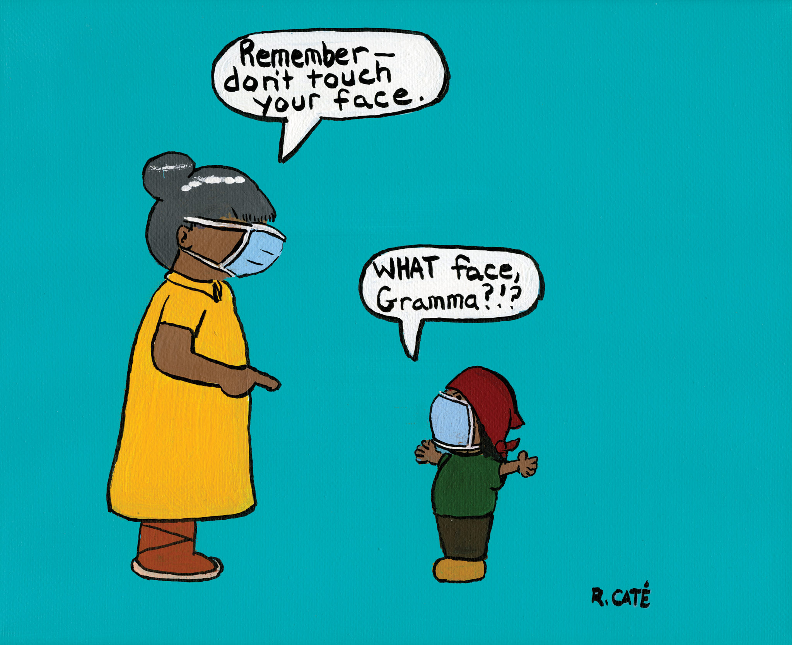

Slide 6
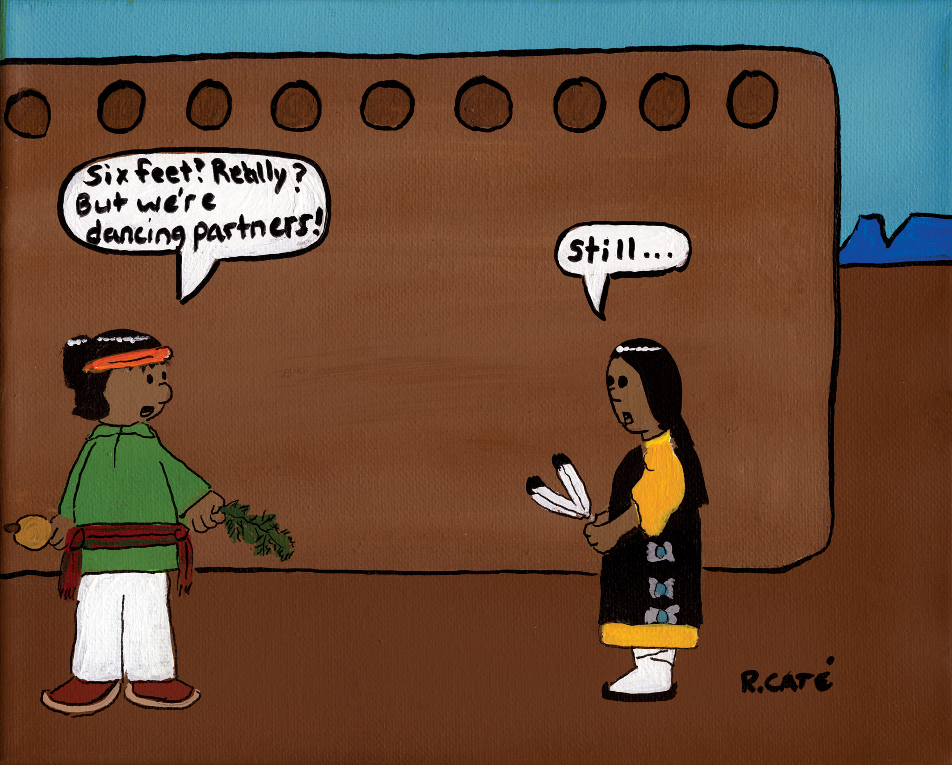

Slide 7
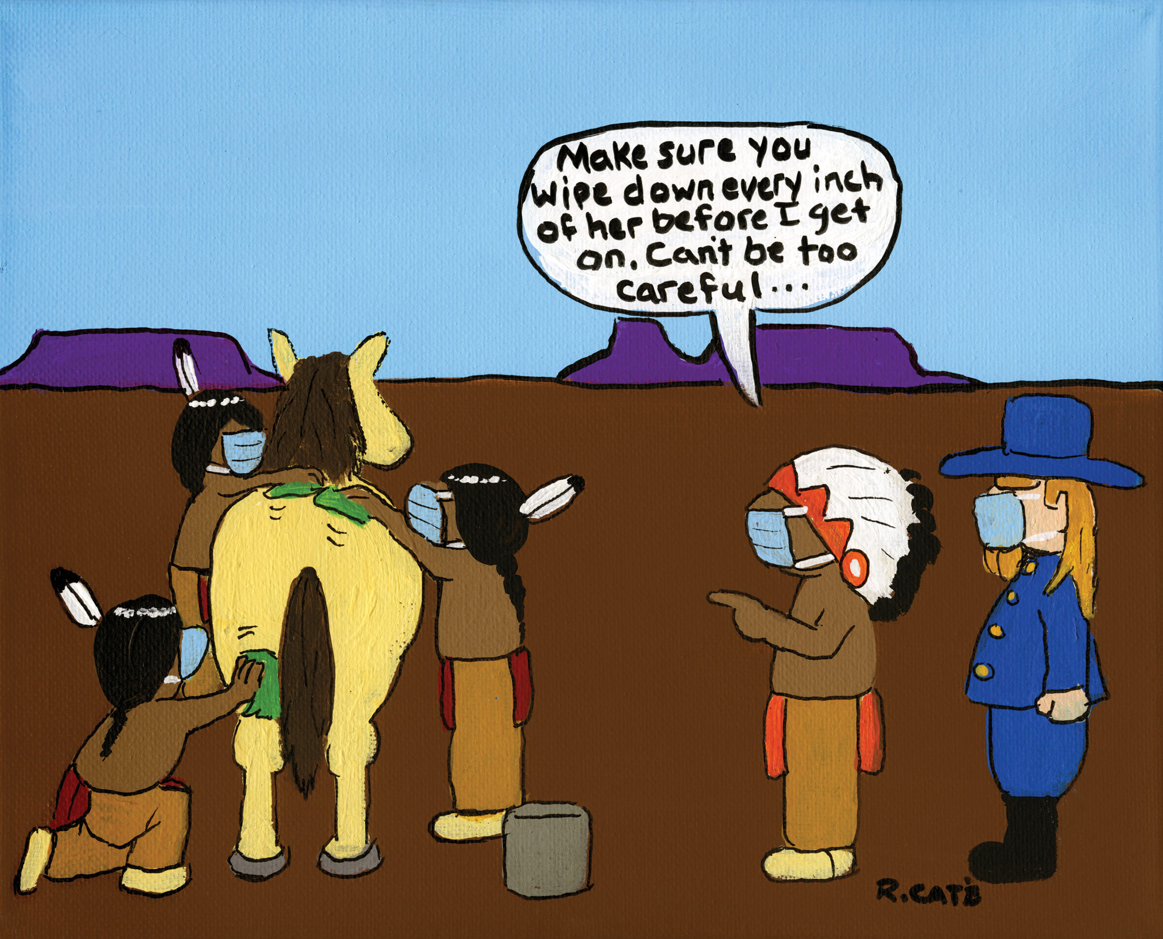

Slide 8
