Slide 1

OSAP Recipient Meeting
August 2019

Slide 2
WHAT DO THESE HAVE IN COMMON?
Colon Cancer
Excessive Sweating
Psoriasis
Obesity
Vape Smoking
Mental Health
Tattoos
Erectile Dysfunction
Irritable Bowel Syndrome
Human Papillomavirus (HPV)
HIV/AIDS
Lung Cancer
Opioid Use Disorder
Medication Assisted Treatment
Notes:
They can all be treated or managed with medication.

Slide 3
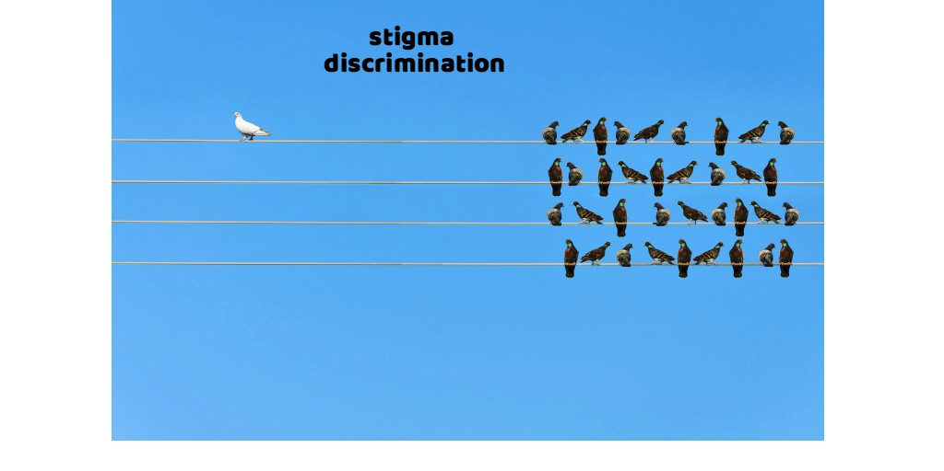

Slide 4
DEFINING STIGMA
A Set of negative beliefs that a group or society holds about a topic or group of people.
It is a major cause of personal and societal discrimination and exclusion that contributes to the abuse of human rights.
When a person experiences stigma they are seen as less than because of real or perceived health status.
Stigma is rarely based on facts, but rather on assumptions, preconceptions, and generalizations.
Notes:
Stigma marks a person as different and devalued. Marks a person as unacceptably different from the “normal” person.
Labeling that leads to stereotyping (links a person to undesirable social characteristics (moral corruption) Separation (us vs. them) Emotional Reaction range of anger, fear disgust) Discrimination occurs when stigmatization is acted on by concrete behaviors like exclusion or rejection. Power Differential is created and and places the individual in a vulnerable position. Stigma affects all of us - and nearly everyone has felt stigmatized or has stigmatized others at some point in their lives.

Slide 5
Results of Stigma
Lowers self-esteem
Damages relationships with loved ones
Less likely to seek treatment
Less likely to practice harm reduction
Experience profound loneliness and isolation

Slide 6
Addiction Is Primarily A Moral Problem
Addiction Is Primarily A Spiritual Deficit
Addiction Is Primarily A Character Disorder
Addiction Is Primarily Poor Willpower
Notes:
Addiction-related stigma is a powerful, shame-based mark of disgrace and reproach.
• Stigma is generated and perpetuated by prejudicial attitudes and
beliefs.
• Stigma promotes discrimination among individuals at risk for,
experiencing, or in recovery from addiction, as well as
individuals associated with them.
• Addicted people and people in recovery are ostracized,
discriminated against, and deprived of basic human rights.
• Individuals who are stigmatized often internalize inappropriate
attitudes and practices, making them part of their self-identity.
Stigma means a mark or sign of shame, disgrace, or disapproval;
of being shunned or rejected by others. It emerges when people
feel uneasy or embarrassed to talk about behavior they perceive as
different.

Slide 7
No one runs a diabetic call and says, ah, that guy, he’s just lazy and doesn’t know how to eat and he’s just a bad person.
If you’re a diabetic, you get your sugar corrected and there’s communication with your PCP.
If you have a heart attack, no one’s gonna blame you for the 50,000 cheeseburgers you ate, you’re gonna get treated, follow up.
Andres Mercado, Santa Fe Fire Department Mobile Integrated Health Officer

Slide 8
Opioid Use Disorder Focus
Health Care Providers
Criminal Justice Systems
Clinical Settings
Loved Ones
Media
Policy Makers
If America approached addiction treatment like any other form of health care, it would go a long way to solving the opioid crisis.
Notes:
The concept of stigma describes the powerful, negative perceptions commonly associated with substance abuse and addiction. Stigma is a public health issue - it contributes to high rates of death, incarceration, and mental health concerns among dependent populations. For our purpose today, we will focus on Opioid Use Disorder Stigma - it is a public health issue that we all need to focus on.

Slide 9
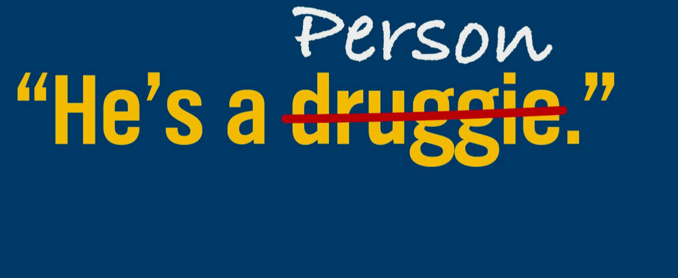

Slide 10
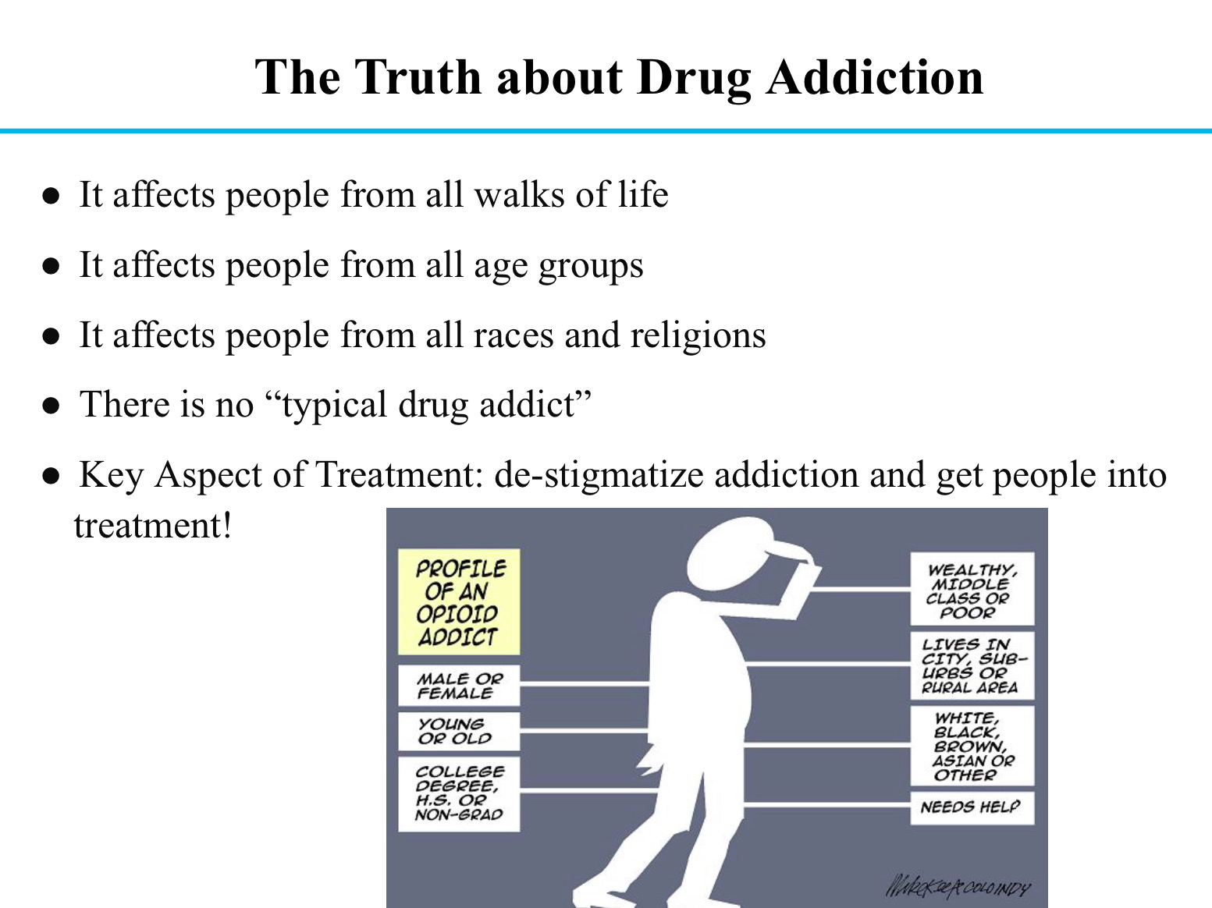

Slide 11
Imagine If Substance Use Disorder Was Treated Exactly Like Heart Disease
Imagine a world in which 90 percent of Americans with heart problems are allowed to suffer and even die without any access to health care.
Imagine that a person suffering a heart attack could go to an emergency room only to be told that the ER doesn’t have any way to treat her.
Imagine that the ER does have a way to help, but the patient who just had a heart attack will have to wait weeks or months to get into any care.
Imagine if this patient went to a doctor’s office for some care only to be told that the providers there don’t see his kind.
Notes:
According to the 2016 surgeon general’s report, just 10 percent of people with a substance use disorder get specialty treatment for their addiction.
Just think, for a moment, if this was true for another medical condition, like heart disease.

Slide 12
The Effects of Stigma
Erodes confidence that substance-related disorders are valid and treatable health conditions.
Avoid socializing, employing, working with, renting to, or living near someone.
Deters the public from wanting to pay for treatment, reducing access to resources and opportunities for treatment and social services.
Stops people from seeking help for fear that the confidentiality of their diagnosis or treatment will be broken.
Gives insurers permission to restrict coverage for treatment services in ways that would not be tolerated for other illnesses. Stops people from seeking treatment because of the fear they won’t be treated with respect or dignity.
Prevents people from acknowledging their substance abuse problems, much less disclosing them to others.
Notes:
persons who have substance-related problems or histories.

Slide 13
Impact on Treatment & Harm Reduction
Perceived stigma in hospitals and doctor office can discourage people from accessing needed healthcare services.
When health providers carry a stigma towards people with drug dependencies, it can affect their willingness to assess or treat the patient.
Criminal Justice System - many incarcerated don’t receive treatment. Seen as criminal behavior.
Evidence-based harm reduction strategies are affected (needle exchanges, substitution therapies and safe drug consumption.

Slide 14
Social Media is Challenging Stigma
Social media enable individuals to bring personal experience into the public domain with the potential to affect public attitudes and mainstream media.
Conversations and user-generated content exchanges are challenging stigma in three ways:
Education
Contact
Protest
Notes:
Stigma is rarely based on facts, but rather on assumptions, preconceptions, and generalizations. Case studies on the role social media in reducing stigma and discrimination in mental health. Education replaces stereotypes with accurate facts; Personal Contact between members of a stigmatized group and others undermines prevailing stereotypes; Protest highlights in justice and rebukes stigmatizing attitudes. Personal narratives are at the core. Ex: Mental Health Patient Halloween Constumes. #Mentalpatient hashtag created by people with lived experiences and posted photographs of themselves along side text such as this is what a real mental health patient looks like. First by individuals and then by organizations. Public figures, charities, activists, public figures, etc.

Slide 15
Dose of Reality Examples
One way we can address stigma at the community-level is to correct misconception.
“Aren’t you treating a drug with a drug?”
“Doesn’t providing naloxone just enable drug users to keep using?”
“Drug addicts are sucking all of our resources.”
“Didn’t drug addicts cause this problem in the first place?”
Notes:
ADOR became the sounding board for chronic pain people who felt the CDC and other NM campaigns were stigmatizing and demonizing them. We developed a response toolkit that we also shared with other campaigns:
At A Dose of Reality New Mexico (ADOR), we do not stigmatize people who use legal or illegal opioids for any reason. We do not judge people who use prescription opioids for physical pain, and we do not judge people who use heroin to cope with their physical, emotional, or psychological pain. ADOR’s job is not only to share information about the health and social issues associated with substance use, but also to reduce stereotyping, stigma, and discrimination. We understand that people use drugs and alcohol for a plethora of reasons, and don’t distinguish the harms they may cause based on whether the drugs are legal or illegal.

Slide 16

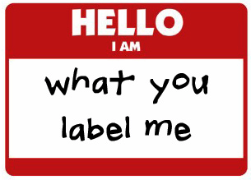
Using Poor Language and Images
Avoid using labels that define people by their condition.
Do not sensationalize the issue of addiction.
Do not generalize populations struggling with addiction.

Slide 17
Prevention Messaging
Ask yourself:
Who is my intended audience, and how can I use language to reduce stigma when communicating with this group?
Am I correcting negative attitudes held by potential allies?
Are you using “person first” language?
Notes:
Every time you develop a prevention message, consider it as an opportunity to dispel myths and convey respect. Ask yourself:For example, when developing a message to encourage people with opioid use disorders to carry and use naloxone, include language that fosters self-worth and encourages self-efficacy. For example, in some communities, first responders may be reluctant to carry naloxone because they characterize people who misuse opioids as criminals who should be punished for breaking the law. You can help to change this perspective by using language that acknowledges the presence of these stereotypes while educating about the nature of addiction and affirming the shared priority of saving lives. Person first language (for example, reference to “a person with substance use disorder”) suggests that the person has a problem that can be addressed. By contrast, calling someone a “drug abuser” implies that the person is the problem.

Slide 18
It’s about words and language
Words to avoid Addict Alcoholic Drug problem, drug habit
Drug abuser
Clean
Dirty
Former/reformed addict/alcoholic
Words to use
Person with substance use disorder
Person with alcohol use disorder
Substance use disorder
Abstinent, not actively using
Actively using
Person in recovery
Notes:
Person-first language is proven to reduce stigma and improve treatment. It's not about being sensitive, or polite, or politically correct. It's about access to quality treatment and care. Person-first language doesn’t define a person based on any medical disorder she may have. It’s nonjudgmental, it’s neutral, and the diagnosis is purely clinical.So what’s the person-first language that we should use to talk about addiction?

Slide 19
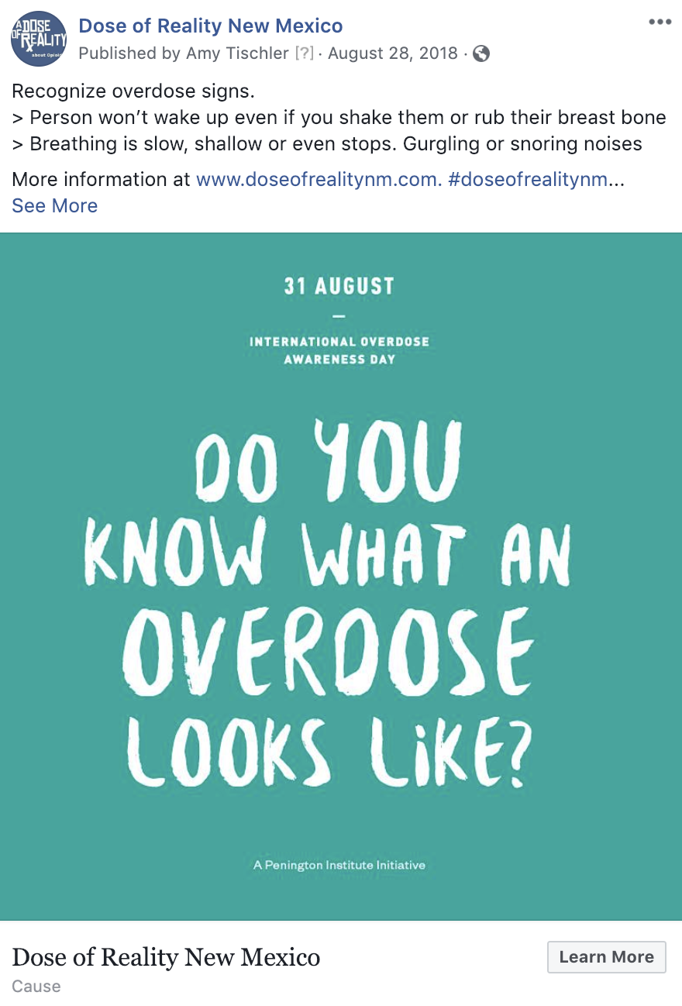
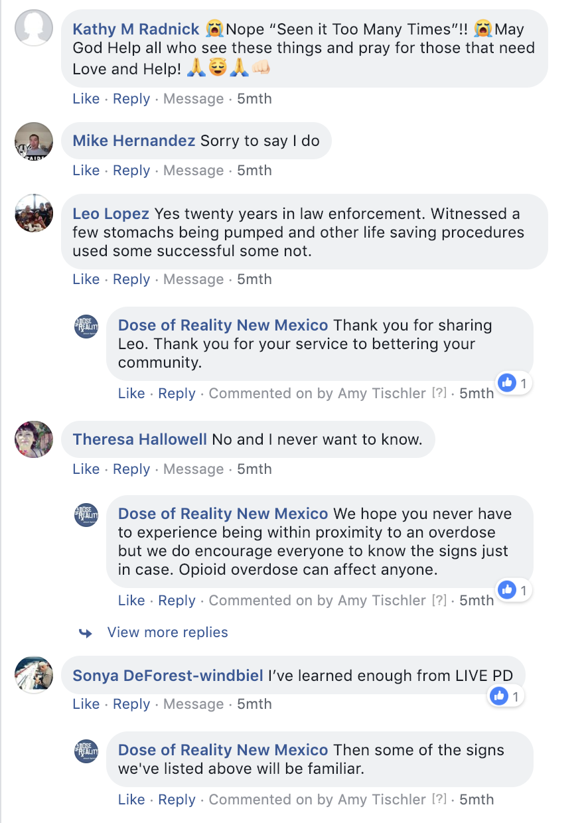
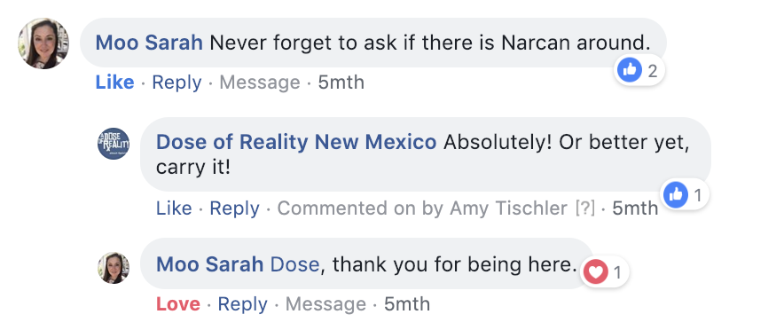

Slide 20
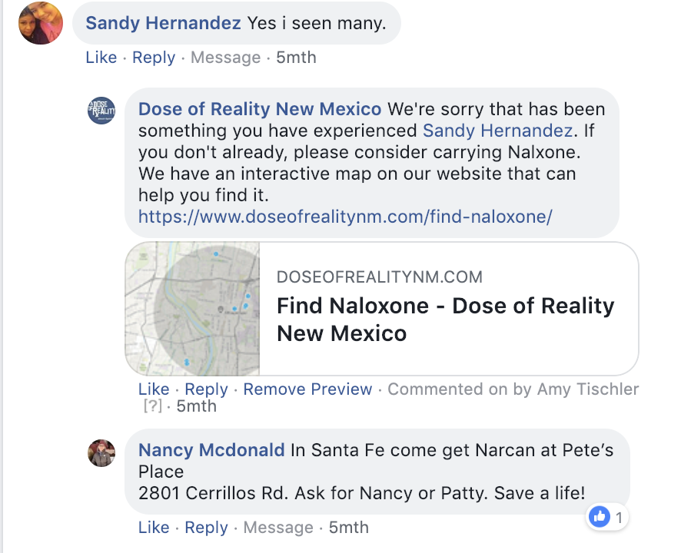
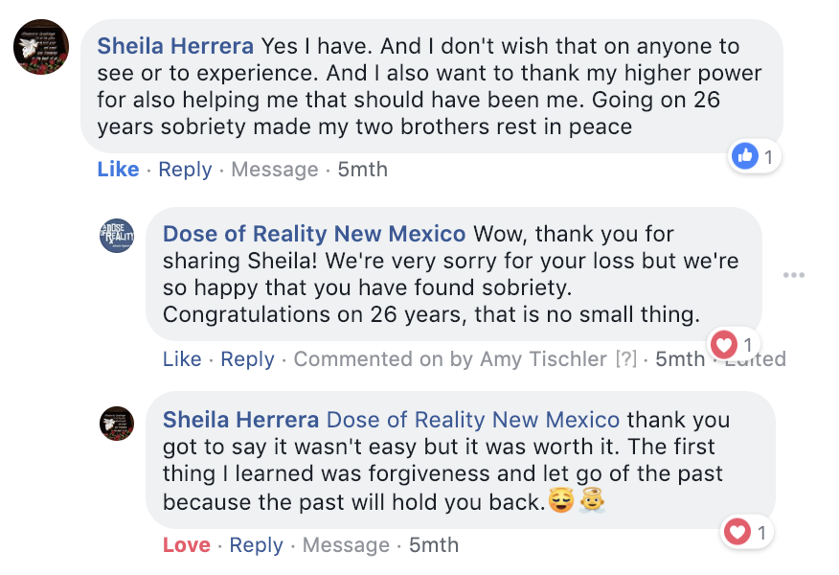

Slide 21
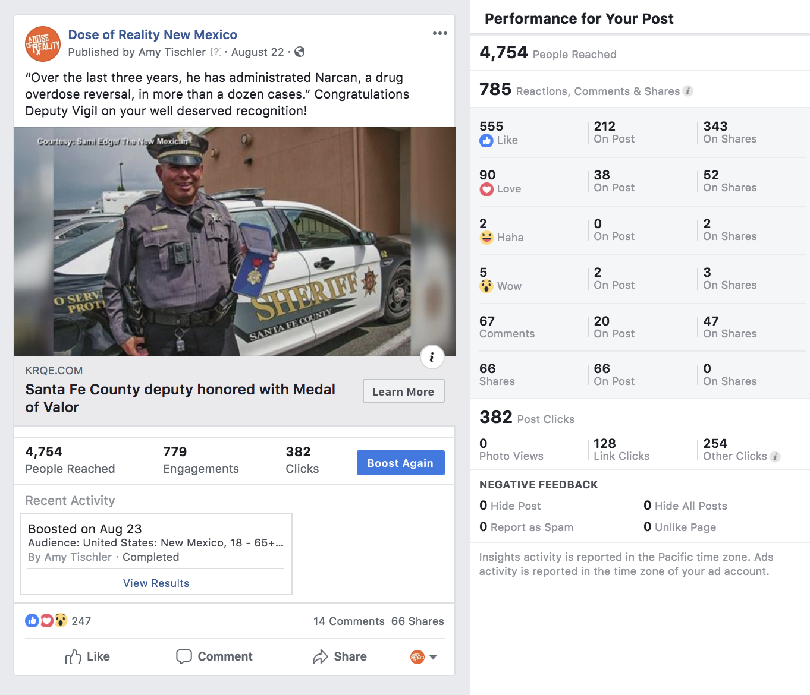
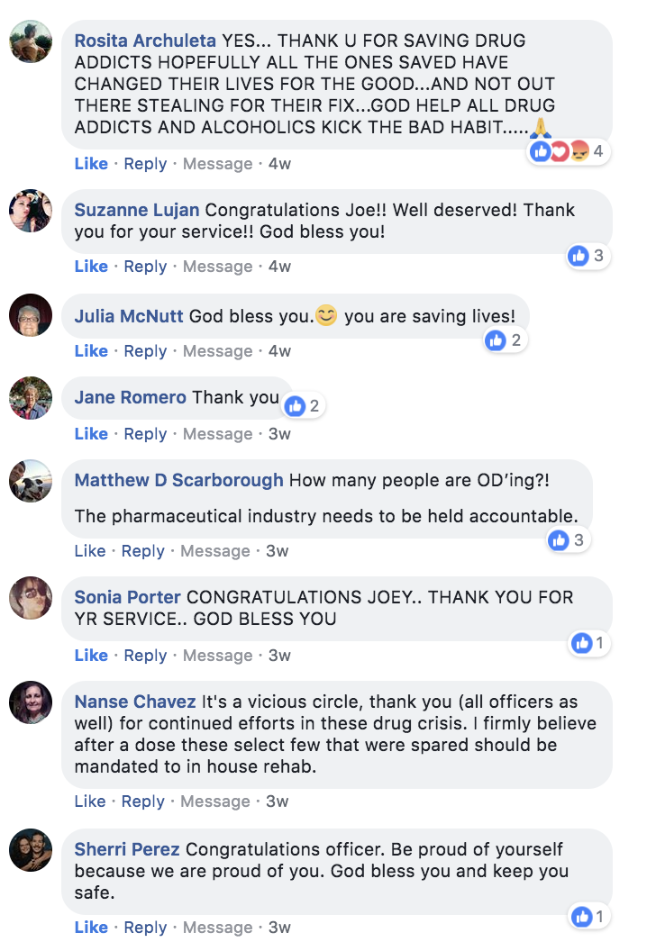

Slide 22
RESERVING THE RIGHT TO REMOVE COMMENTS
Where comments are welcomed, we encourage users to use the feature to share their thoughts, questions, and opinions.
Please be sure your comment is relevant to the video, photo, or post to which you’re commenting.
Comments should contribute to the dialogue and be respectful of Dose of Reality, New Mexico Behavioral Health Services Division, New Mexico Office of Substance Abuse Prevention and the Substance Abuse and Mental Health Services Administration (SAMHSA) and other commenters.
Personal attacks and foul language are not tolerated. Those type of comments will be deleted and the user will be banned from the social media platform.

Slide 23
Stigma Videos
https://youtu.be/AN2gOGTKwzY (ADOR - BERNIE)
Notes:
End with this video. You can also look at Wayne’s interview for his comments on discrimination vs. stigma.

Slide 24
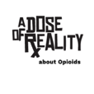
Stigma Resource
SAMHSA’S CENTER FOR THE APPLICATION OF PREVENTION TECHNOLOGIES November 2017 http://www.samhsa.gov/capt/
DoseOfReality.com
a
Notes:
Check back often as we are in the process of developing new materials for stigma and be sure to follow dose of reality on social media for how to avoid unintentional stigma posts and how best to respond. After the conference, you will receive our toolkit for stigma responses.

