Slide 1
Excessive Alcohol Consumption and Alcohol-related Harms, NM 2013-2017
Annaliese Mayette
Substance Abuse Epidemiology Section
Injury and Behavioral Epidemiology Bureau
Epidemiology and Response Division
NMDOH

Slide 2
Excessive Alcohol Consumption

Slide 3
Impact of Excessive Alcohol Consumption:
Nationally, excessive alcohol consumption is the 3rd leading cause of preventable death. Tobacco use, and obesity/inactivity are the first and second.
New Mexico has the highest rate of alcohol-related deaths in the United States
New Mexico’s alcohol-related death rate is almost twice that of the U.S.
In New Mexico in 2017 there were 1,461 deaths due to excessive alcohol.
Excessive alcohol use has both a human and a financial cost. Excessive alcohol consumption costs NM about 2.2 billion dollars annually, which is an average of more than $1,000 per resident per year.

Slide 4
In NM in 2017:
1 in 7 adults reported binge drinking.
On average, adult binge drinkers binged 5 times per month
1 in 4 high school students reported drinking in the past month.
More than half (54%) of high school students who
drink report binge drinking.
Almost 1 in 20 high school students who drink report
high intensity binge drinking
1 in 10 middle school students reported drinking in the past month. Almost half (49%) of middle school students who drink report binge drinking.
Binge Drinking Definition:
Women: 4 or more drinks on an occasion
Men: 5 or more drinks on an occasion
High Intensity Binge Drinking Definition:
10 or more drinks on an occasion

Slide 5
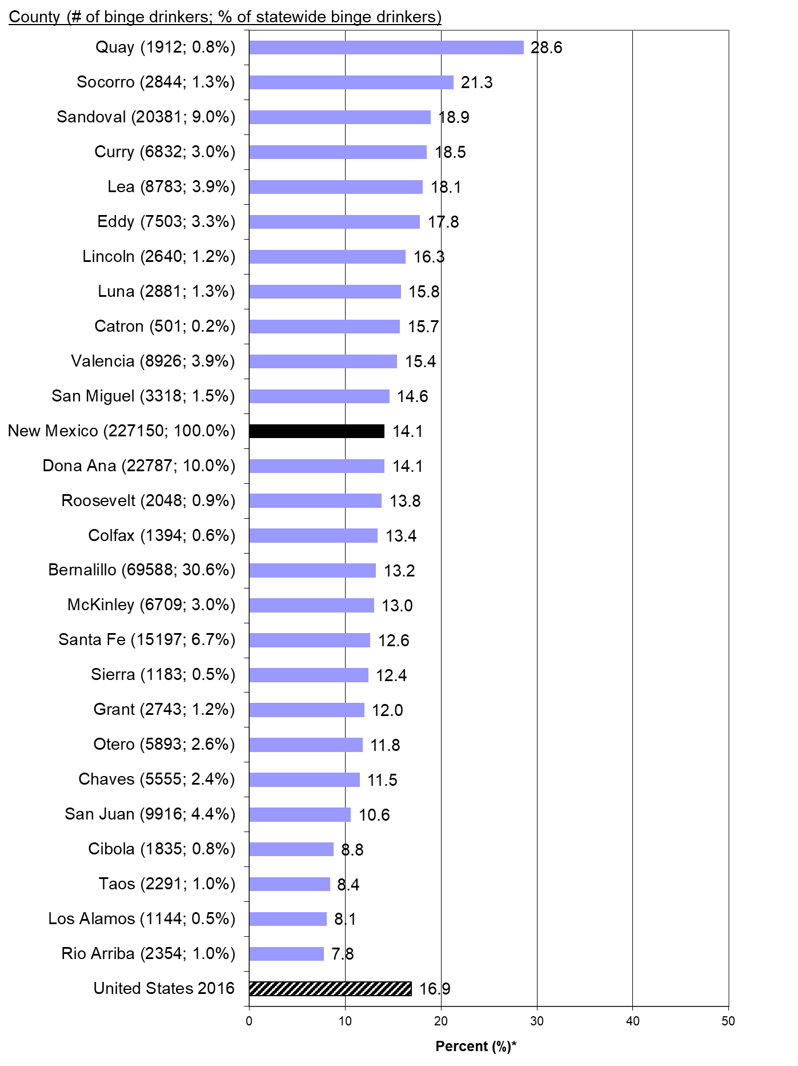
Binge Drinking (last 30 days)*, Adults Aged 18+, New Mexico 2013-2017
*Estimate of percent of people in population group who reported binge drinking at least once in past 30 days
Source: NMBRFSS (NM); CDC BRFSS (US); SAES

Slide 6
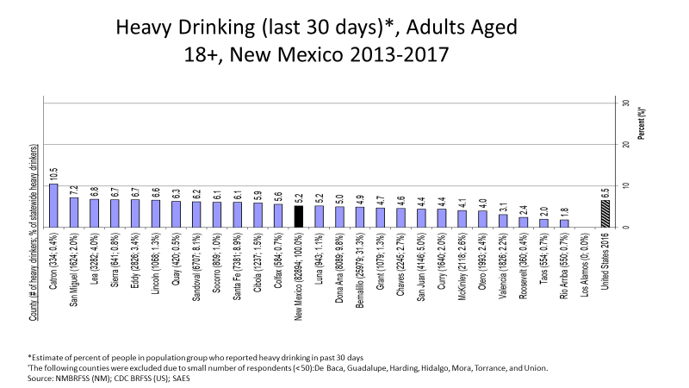

Slide 7
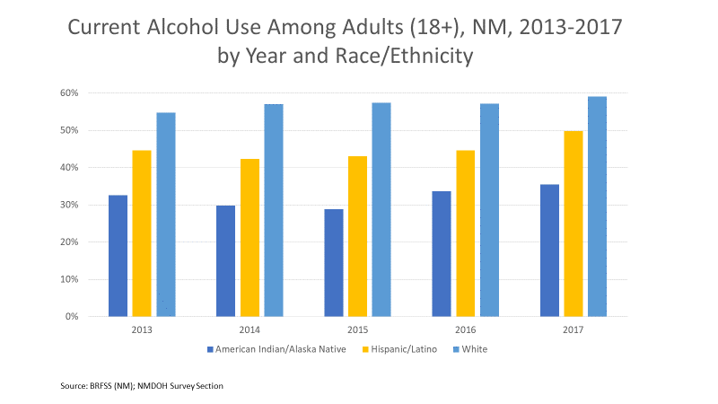

Slide 8
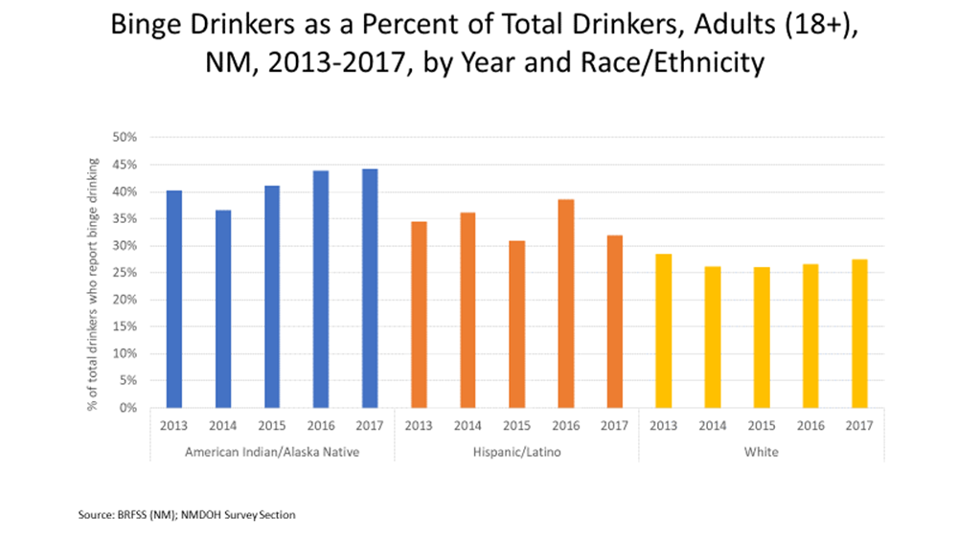

Slide 9
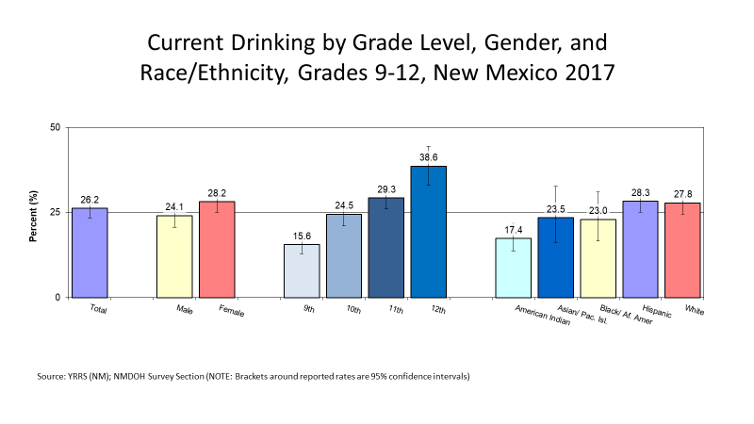

Slide 10
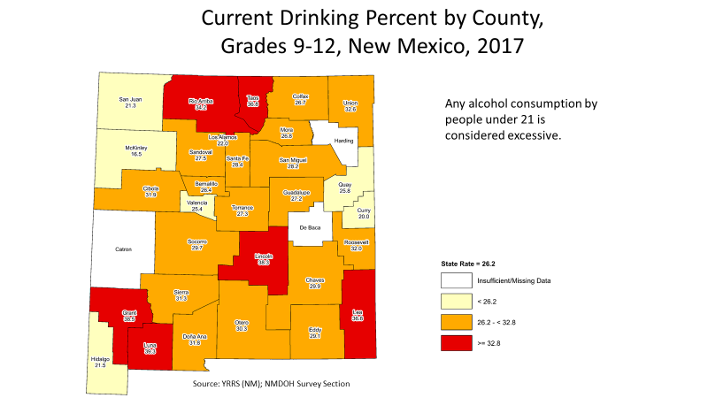

Slide 11
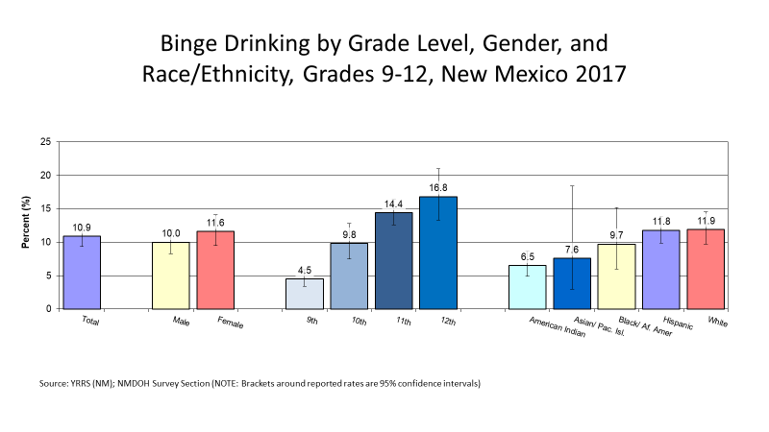

Slide 12
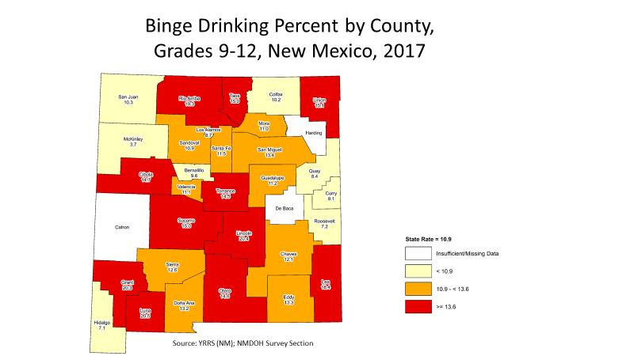

Slide 13
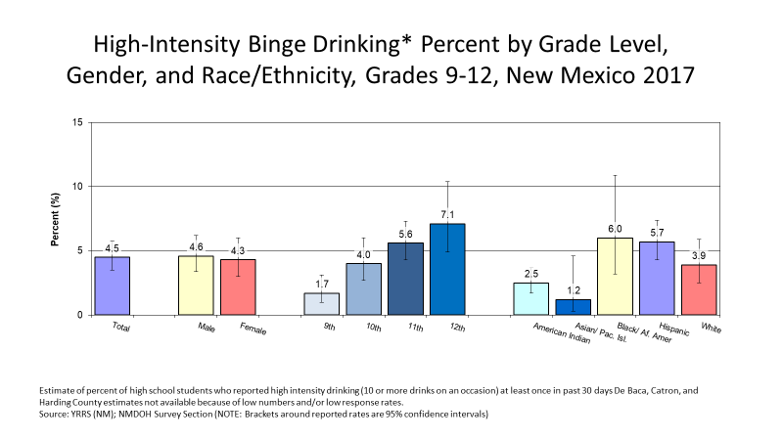

Slide 14
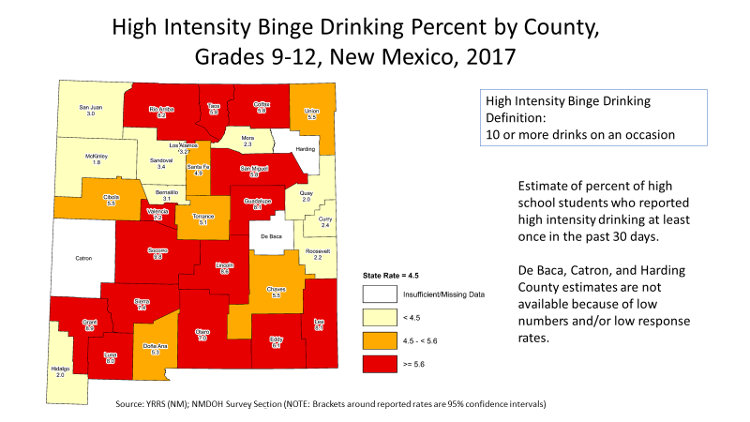

Slide 15
NM Youth Risk and Resiliency Survey is administered to NM Middle School and High School students every other year (in odd years).
More information, including special reports, and county- level reports can be found at: http://www.youthrisk.org/

Slide 16
Consequences of Excessive Alcohol Consumption

Slide 17
Alcohol-related deaths in NM:
Males have more than twice the alcohol-related death rate of females
Native Americans have the highest alcohol-related death rate, and Asian/Pacific Islanders have the lowest alcohol-related death rate
People over 85 have the highest alcohol-related death rate. They also have the highest overall death rate.
* Rates are per 100,000 population, rates for sex and race/ethnicity are age adjusted to the standard 2000 US population

Slide 18
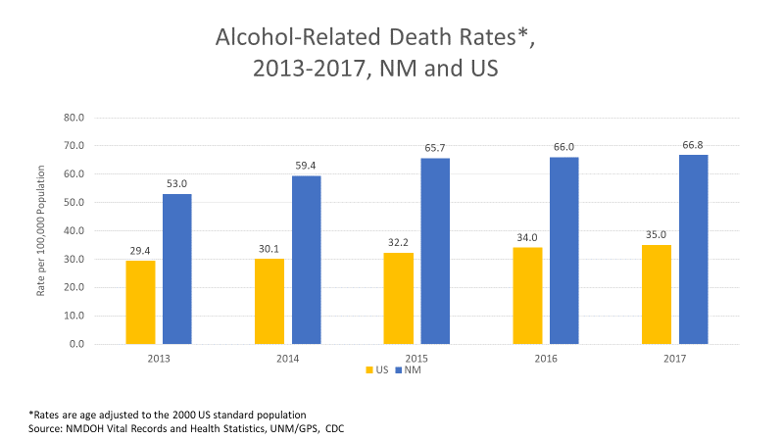

Slide 19
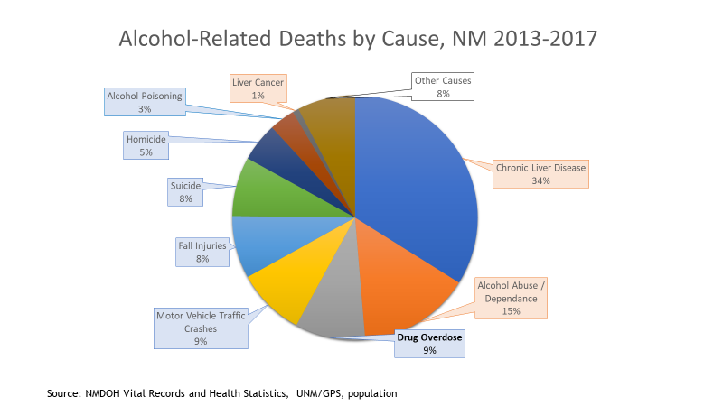

Slide 20
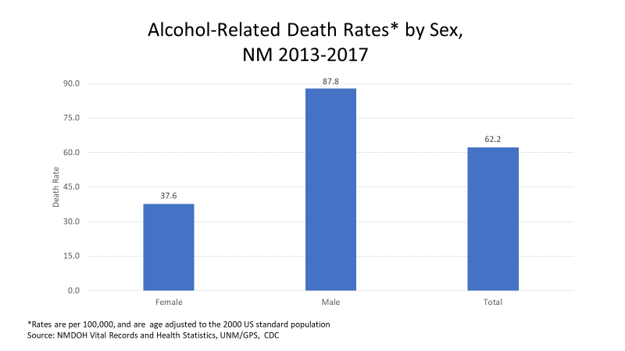

Slide 21
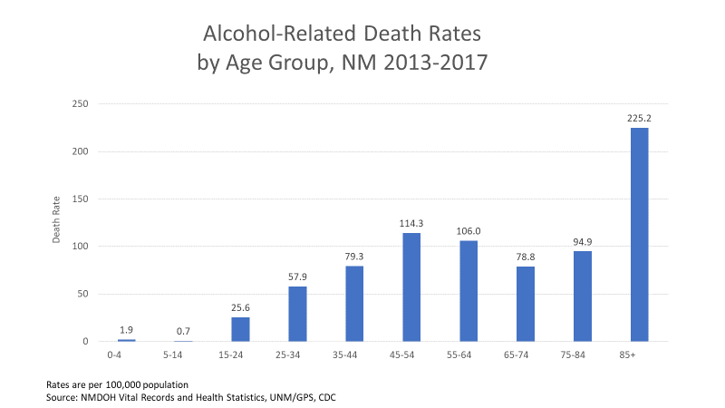

Slide 22
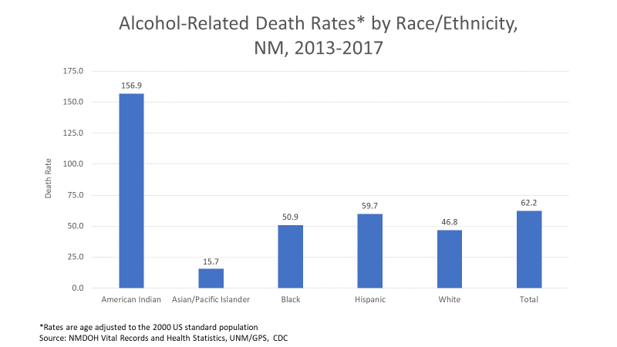

Slide 23
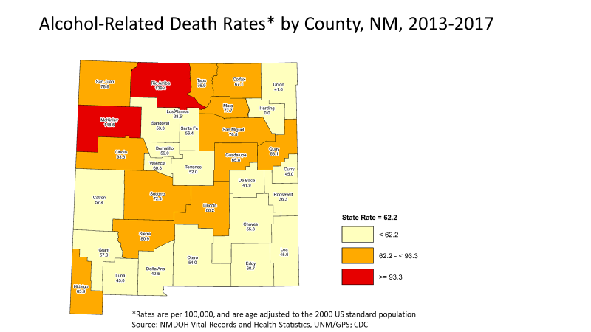

Slide 24
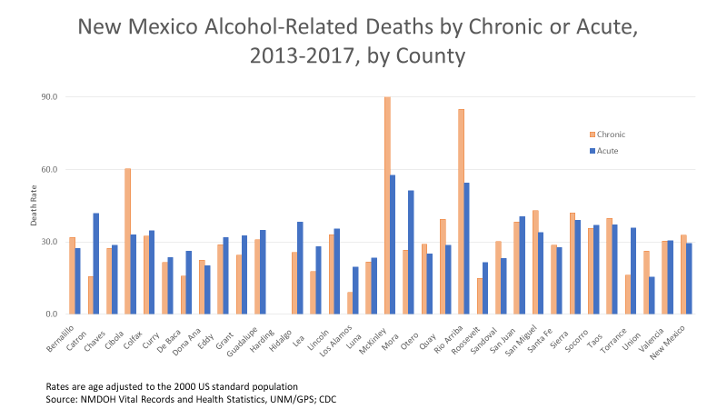

Slide 25
Alcohol and Opioids

Slide 26
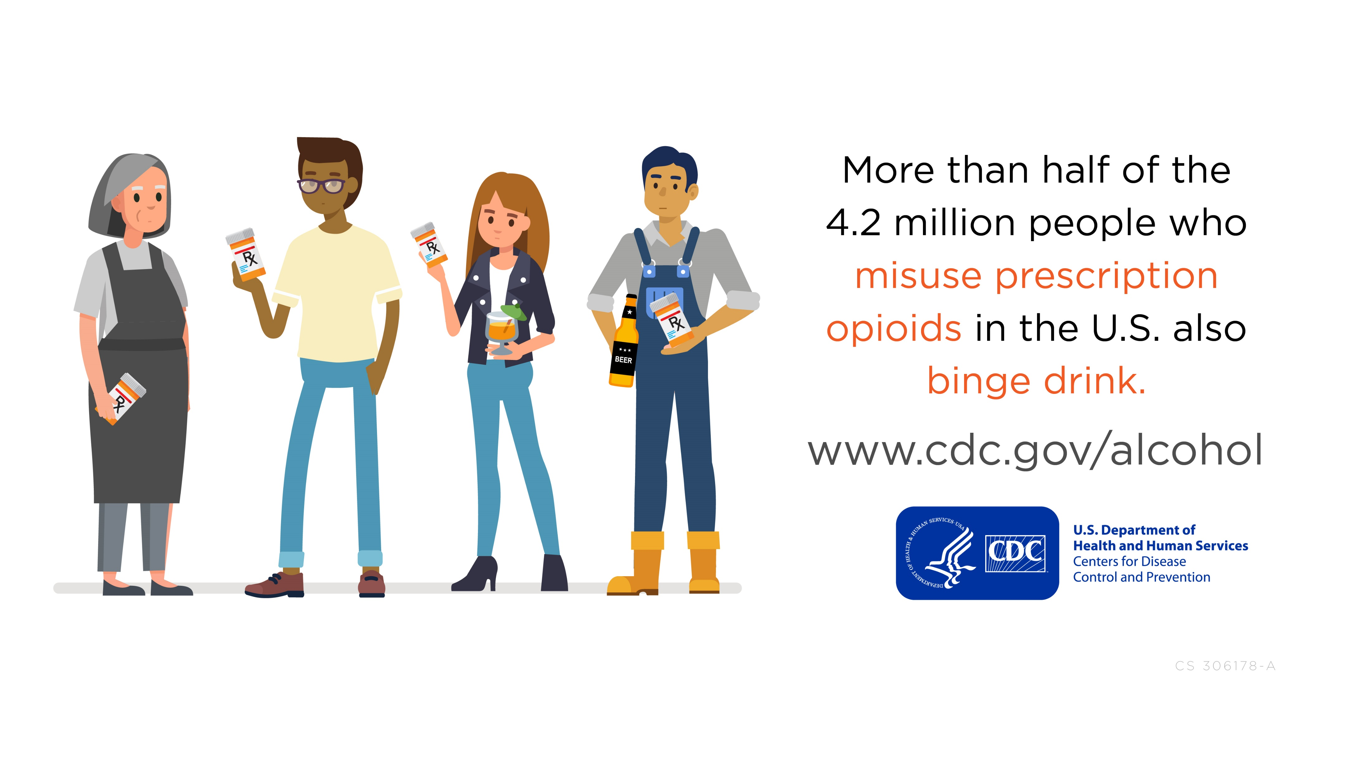
What can be done to reduce excessive alcohol consumption?

Slide 27
Prescription Opioid Misuse and Binge Drinking
A recent CDC study* found that :
More than half of the people who report misusing prescription opioids also report binge drinking.
Binge drinkers misused prescription opioids at almost twice the rate of non-drinkers.
People who reported drinking but not binge drinking had prescription opioid misuse rates similar to non-drinkers.

Slide 28
Prescription Opioid Misuse and Binge Drinking (cont)
The study also found that:
‘Prescription opioid misuse among people who binge drank varied by age and social factors
While young people who binge drank had higher rates of prescription opioid misuse, 2 in 3 people who binge drank and misused prescription opioids were age 26 years and older.
Prescription opioid misuse was more common among people who binge drank with lower education and income levels.
Prescription opioid misuse increased with the frequency of binge drinking.’ (https://www.cdc.gov/media/releases/2019/p0611-people-opioids-drink.html)

Slide 29
Prescription Opioid Misuse and Binge Drinking (cont)
Links to the study (full text), and the summary:
(https://www.ajpmonline.org/article/S0749-3797(19)30157-6/fulltext)
(https://www.cdc.gov/media/releases/2019/p0611-people-opioids-drink.html)
Data Sources:
This study used NSDUH data from 2012-2014
Definitions:
Binge drinking was defined based on CDC’s usual definition (5 or more drinks on an occasion for men, 4 or more for women)
Prescription opioid misuse was defined as ‘the use of these drugs without a prescription, or use only for the feeling the drug causes.’

Slide 30
Prescription Opioids and benzodiazepines (along with many other medications) carry warnings about dangerous interactions with alcohol.
About 9% of all alcohol-related deaths in NM in 2017 were due to drug overdose.
About 22% of all drug overdose deaths in NM in 2017 involved alcohol.
Alcohol, opioids, and benzodiazepines are all respiratory depressants (decrease breathing).
Using alcohol or a benzodiazepine (or both) along with opioids increases risk of death.

Slide 31
Recommendations to Prevent Excessive Alcohol Use

Slide 32
U.S. Community Preventive Services Task Force Recommendations to Prevent Excessive Alcohol Use
https://www.thecommunityguide.org/topic/excessive-alcohol-consumption

Slide 33
Community Preventive Services Task Force (CPSTF) Recommendations to Decrease Excessive Alcohol Use
and Related Harms:
  Electronic screening and brief intervention
  Increasing alcohol taxes
  Dram shop liability
  Maintaining limits on days of sales
  Regulation of alcohol outlet density
  Maintaining limits on hours of sales
  Enhanced enforcement of laws prohibiting sales to minors

Slide 34
Other Recommendations to Prevent Unhealthy Alcohol Use
Alcohol screening and brief intervention (ASBI) for adults (18+)
  https://www.uspreventiveservicestaskforce.org/Page/Document/RecommendationStatementFinal/unhealthy-alcohol-use-in-adolescents-and-adults-screening-and-behavioral-counseling-interventions

Slide 35
Thank You!
Annaliese Mayette, Ph.D.
Alcohol Epidemiologist
Annaliese.Mayette@state.nm.us
Substance Abuse Epidemiology Section
Injury and Behavioral Epidemiology Bureau
Epidemiology and Response Division
NM Department of Health
This presentation was supported by Cooperative Agreement Number NU58DP001006 from The Centers for Disease Control and Prevention. Its contents are solely the responsibility of the authors and do not necessarily represent the official position of the Centers for Disease Control and Prevention.

