Slide 1

Collecting Process data
for (most) OSAP-approved strategies

Slide 2

Process Evaluation assesses….
  the program process, including the activities and operations of the program;
  fidelity to the strategy being implemented;
  effectiveness of program implementation (did you do what you said you were going to do with the stated target group, at the stated time, etc.)
    a.k.a.: Implementation assessment, program monitoring
Process evaluation addresses questions related to how well the program is functioning.
Notes:
NOTE: The PIRE handbook, which addresses environmental prevention evaluation, states that this is not the approach is used in environmental prevention evaluation. However, we do use process measures in our efforts to get to a strong outcomes evaluation in NM.
Fidelity may be defined as the extent to which delivery of an intervention adheres to the protocol or program model originally developed

Slide 3
Process Evaluation
Identify the critical program activities and their measures of performance
Activities may take the form of specific administrative or service objectives:
  “enroll 20 new clients each week”
  “hold a town hall meeting”
  “provide a minimum of 10 sessions of service to 90% of participants”
  “Write 1 letter to the editor once a week on topics related to underage drinking”
Notes:
First Step: To successfully conduct a process evaluation, you first need to define what the expectations are. What are the pieces that must be implemented if it is to work? This can be a list, a flow chart, or whatever is easiest. But identifying what needs to be done and by whom and in what order, is a big start.

Slide 4
  Activities tracked in process evaluation…
    Might be determined by program administrators or funders (Sometimes defined as “deliverables”). “Activities” in your SOW.
    And should be:
      derived from studies and reports about similar programs, and /or follow specification of some model program
      drawn from accepted principles of organizational effectiveness or professional practice
      a part of a process of reflection and goal setting by program personnel or other stakeholders (coalitions)
      Documenting those activities is documenting your fidelity to the strategy.
Notes:
Think about your scope of work, “activities”

Slide 5
Process helps you tell the story of your strategy
Environmental strategy implementation can vary from community to community, so there is a need to document how work was done.
Did you implement the strategy with fidelity?
How much work/effort/collaboration does this strategy require?
  Do you need more media, what kind?
  Do you need to reach out more to key strategy stakeholders?
  Who (else) do you need to reach out to and how?

Slide 6
OSAP strategy-level evaluation requires tracking Outcome and Process data
Outcome Measures
Process Measures
Measured at least annually
Help track your progress towards goals/priorities
Matched to strategy through Objective language (in SMART DOC)
For example:
  NMCS (eg. providing alcohol to a minor; perception of risk of legal consequences;
  ASFS (eg, access to alcohol and Rx Opioids; perception of risk of getting caught)
  Enforcement activities (eg, # of party patrols)
  Policies changed/enhanced
Trackable throughout the year
Help track progress within your strategy
For example:
Policy/enforcement –
  Meetings, communications tracking, key stakeholders, description of process itself
Media/education –
  Kind of information distribution;
  Message
  #s reached, demographics
  Dates, frequency

Slide 7
Process of self-analysis
  Was there change the Objective/Outcome indicator?
  (remember that outcomes are population-level)
  Why did the change happen?
  What were contextual or community factors?
    changes in enforcement funding or regulations about enforcement,
    changes in key stakeholder/policymaker leadership
    Changes in staffing in program
  How did you/could you respond to these factors?

Slide 8
What implementation occurred?
How much of your target population did you reach?
  Who is your target population?
  Are you interacting with the right people? (I put it on our FB page!)
  Who’s missing?
How did you reach your target population? (radio, newspaper, SM?)
  When did you reach them? (do you need to calendar your activities? )
How often was that population reached
Esp. for education/media related strategies, how closely did your content match the strategy and objective? (fidelity)
  Is the messaging on point? Eg (Don’t drink and drive vs. don’t provide alcohol to a minor)
  Is the messaging appropriate for your population?
  Are you using best practices for messaging and messaging that is appropriate for your community? (eg, Not reinforcing negative norms)

Slide 9
Tracking your process data

Slide 10
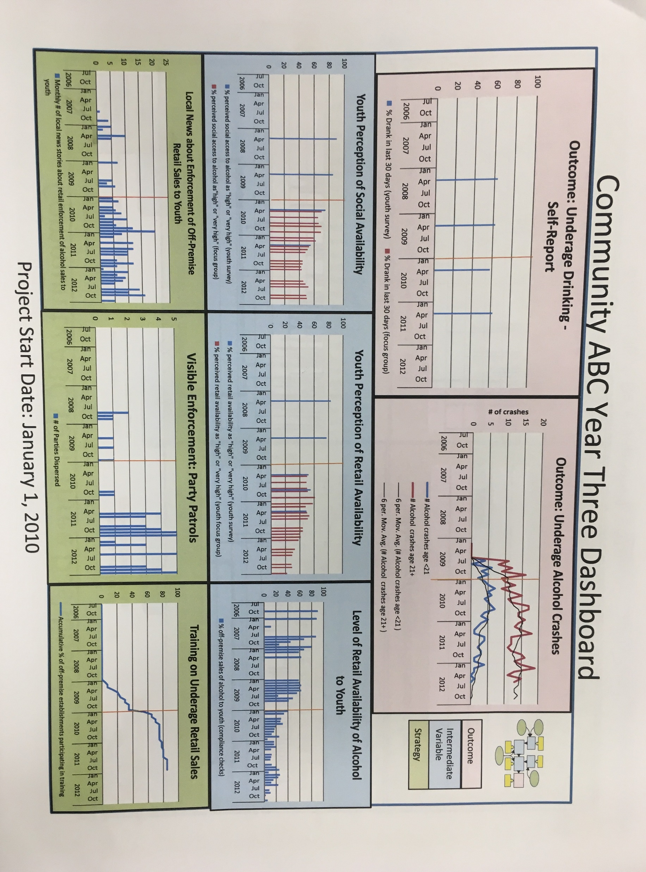
visualizing process & outcomes
Source: Holder & Carina 2013

