Slide 1
The New Mexico Community Survey Fiscal Year 2014
What’s happening and what to expect
OSAP Recipient Meeting
August 27, 2013

Slide 2
Current NM Community Survey Data Collection Limitations
Convenience sample not random
Hard to reach young adults in particular
Males are less likely to participate; perhaps less likely to be asked to participate?
Cannot collect data in all 33 counties
Not quite as anonymous as we might prefer

Slide 3
The “NEW DEAL”
The NM MVD has agreed to assist us with selecting a random sample of licensed NM drivers.
18 to 25 year olds *(target population for the PFS-II)
26 to 45 year olds
In every county
Power analyses (based on 2010 U.S. Census data) determined the # of 18 to 25 year olds and 26-45 year olds to sample within each county (Total N = 25,000)
The MVD will draw the samples for us, getting names, mailing addresses, & unique identifying numbers
Through their contractor, they will print & mail invitation cards to the entire sample.
The card will invite people to take an on-line survey.

Slide 4

The Invitation

Slide 5
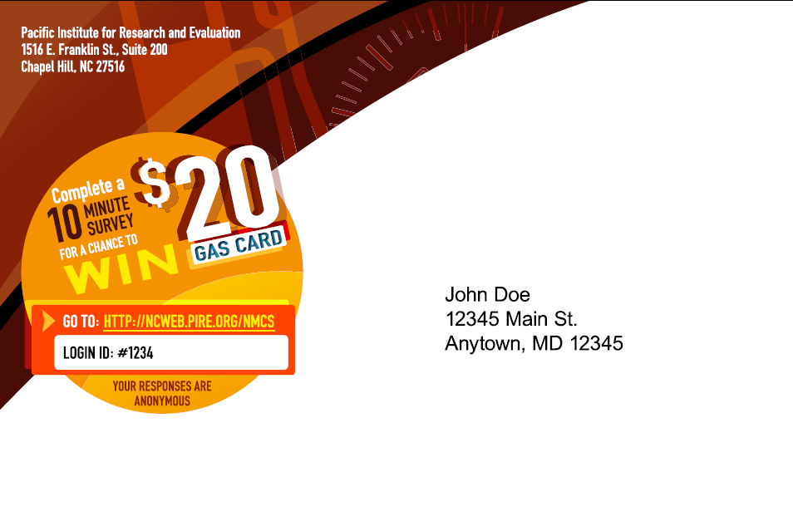

Slide 6


Slide 7
How will it work?
Everyone in the sample will be sent the initial invitation.
The first 250 to complete will automatically receive a $20 gas card.
Another 250 will be randomly selected at the end of the survey to receive a $20 gas card.
Non-respondents only will be sent a reminder invitation 1 month after the first card.
The survey will close after 2 months and gas cards will be mailed from the MVD contractor.

Slide 8
Advantages
  Truly a random sample of 18 to 45 year old licensed drivers
  Truly anonymous. At no time will PIRE have names and addresses. Only unique IDs and at no time will the MVD have any respondent data.
  Every county in NM will be represented
  Data will not need to be entered by communities
  If successful, cost-effective and less labor intensive
  We’ll have county and zip code data so it’s feasible we can explore smaller geographic areas
  Quick turnaround of data
  Actual baseline data for the PFS II counties and comparison counties

Slide 9
Disadvantages
  Only targets ages that are most likely to have access to internet services
  Not all addresses will be good ones
  We have no idea what the response rate will actually end up being; no one has ever done this
  New timing of the survey (fall vs. spring) may throw off CBP’s

Slide 10
Timeline for the NMCS
September 27th – first round of invitations will be mailed (First 250 respondents will be mailed gas cards soon after.)
October 25th – reminder invitations will be mailed
November 22nd – Survey closes
December 6th – All additional IDs (after initial 250) will be provided to MVD
December 13th – 250 respondents will be mailed gas cards

Slide 11
Updates on survey itself:
To increase reporting, respondents are asked to identify age groups, not actual age
LGBTQ status (YRRS will also have 2 new questions this year!)
Education level (proxy for socioeconomic status)
Slight changes to Rx drug and mental health questions

Slide 12
You may still need and/or want to…
Collect your own Community Survey data targeting specific subpopulations, e.g., elderly, Native American
  We will continue to provide you with the data entry templates, the SPSS syntax needed to analyze the data you collect. We will also provide you the data collected on-line.
Look at the new questions added and changes to several of the existing questions that you all provided feedback on last time around.
  If you still need to collect additional community survey data, you may not want to ask all of the questions on the paper survey depending on what and who you are targeting and what your community partners’ needs are.

Slide 13
How do I know when I should collect data?
Review your evaluation plan and scope of work: do you have objectives that can only be measured with the NMCS? (eg., perception of risk?)
If so, you must adapt to how the NMCS is changing from spring to fall
If you are a program that needs or wants to collect data from a specific subsample that the on-line NMCS does not target (18-45 by county) please plan to collect additional data this fall over the same 2 month period.
  These might include any communities that need data on adults 46 and older addressing youth access to alcohol or Rx drugs, small Native American communities for which county level data will be insufficient, at-risk sub-populations of interest for your coalitions such as LGBTQ, homeless, veterans, elders, etc.
If you do not need to collect data for populations not targeted in the on-line NMCS, then wait until we know for sure whether the sample we have for your county is sufficient (December).
  If the sample is good, then just prepare to evaluate your programming using the NMCS on a fall-fall schedule.
  If the sample is not sufficient, prepare to collect additional surveys in the spring. Communicate with PIRE to figure out the best way to proceed.

Slide 14
If you still require additional NMCS data :
Revise your NMCS data collection protocols, using new Venue-based Time Space Sampling technique.
  PIRE will provide an online training for this improved data collection technique in early September.
Continue using a standardized data collection methodology to improve multi-year comparisons of your data.
Everyone collecting surveys on your own will need to submit a protocol to PIRE by September 25th for fall collection.
  Those who require additional data collection for the spring can be addressed case by case, but a revised protocol will still be required.
  PIRE’s IRB will require that members of the SEOW review protocols
  If inviting specific sub-populations to complete the survey online (for specific populations like universities) PIRE needs to also be informed early so that a separate database can be made available.

Slide 15
Venue-Based Time-Space Sampling
Venue-Based TSS is a similar approach to what communities have been doing already when collecting community survey data, just more systematic with respect to selecting locations, times of day, etc.
By increasing the rigor of the data collection methodology, you increase integrity of the data and the data will be more comparable from year to year.
Everyone planning to submit a September data collection protocol should attend the September webinar. It is only recommended to the other prevention programs, but learning about this technique will strengthen your local data collection methodology, especially if you or your community partners wish to collect similar data in the future. We will repeat the training in the spring for those who require additional survey data collection.

Slide 16
Comments & Questions
Huge thanks to Raul Alvarez a the MVD!!!
How do I know if I need to do the community survey myself?
  You only need to do it yourself if the MVD-CS data is insufficient in order to evaluate your programming.
    Review your objectives and evaluation plan: some objectives require community survey data to measure change.
    Results should be available by county and even zip code. However, for some sub/populations the representation may be inadequate to create reliable estimates.
So what do we do if we find that the sample isn’t good enough in my community in order to meet our evaluation needs?
  Since this is the first year, we recommend that as soon as we have a good idea about your sample, you try an abbreviated survey in the spring.

Slide 17
More anticipated questions (and answers)
If we already know that we will have to do paper and pencil surveys, should we do them in the fall in order to make the results match with the broader CS, or in the spring as we’ve done in the past?
  We would recommend that you do them in the fall if at all possible so that time matches.
Will we get results already analyzed for us, or will we have to do that ourselves?
  You will receive the raw data to analyze according to your needs (for specific subpopulations for example).
  You will be provided syntax and data entry templates as in the past.
  However, basic frequency results will eventually be available by county and accessible to everyone.

Slide 18
Other Questions, Comments, Concerns?

