Slide 1
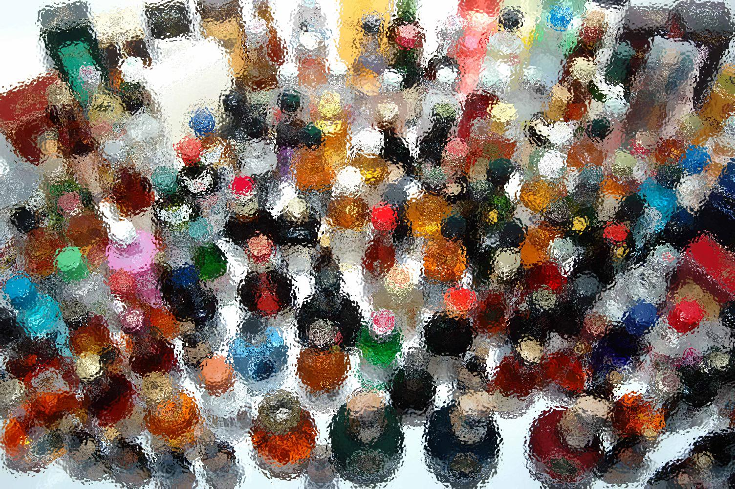
Current Challenges to Alcohol Regulation in New Mexico
Outlet Density & Service Rules
Notes:
As of 8/16/2013

Slide 2
OVERVIEW
Purpose: Bring the voice of prevention to the Alcohol Gaming Division (AGD) and legislators to inform the decision-making process around any rule or statute changes that might increase alcohol-related harms:
Organize advocacy efforts to address alcohol outlet density policy on the state and local level
Organize advocacy efforts to address alcohol service rules on the state and local level
Encourage community and small group meetings with AGD Director and elected officials, providing education and data about best practices in alcohol policy

Slide 3
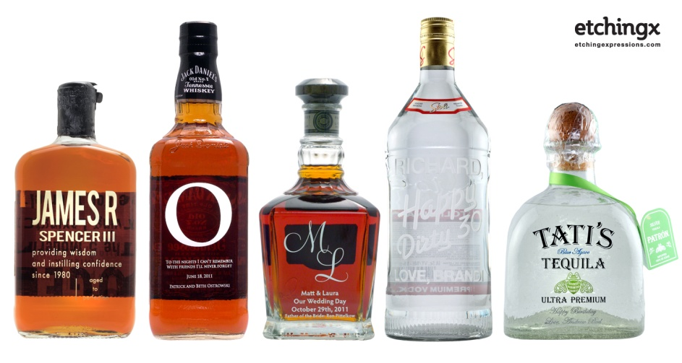
ALCOHOL OUTLET DENSITY
According to the Centers for Disease Control and Prevention (CDC), “An alcohol outlet is a place where alcohol may be legally sold for the buyer to drink there (on-premises outlets, such as bars or restaurants) or elsewhere (off-premises outlets, such as liquor stores). Density refers to the number of alcohol outlets in a given area.”

Slide 4
STRUCTURE
Governor
RLD Superintendent
AGD Director
Regulations and Licensing Department
Alcohol and Gaming Division

Slide 5
STRUCTURE
Governor
RLD Superintendent
AGD Director
Alcohol and Gaming Division issues, transfers and revokes liquor licenses as specified in the Liquor Control Act. It administers the Alcohol Server Training Program, educating licensees and servers to prevent sales of alcoholic beverages to minors and intoxicated persons. AGD adjudicates administrative citations for violation of the Liquor Control Act.

Slide 6
POLICY
State statute provides the guidelines, the administrative code is dictated by the Division, ‘rules’ or ‘regulations’ provide more guidance to ensure consistency statewide.
Governor
Statute (what to do)
Rules (how to do it)
Notes:
These are the areas where we, as preventionists, have an opportunity to proactively impact the process.

Slide 7
STATE STATUTE: Alcohol Outlet Density
Limitation on number of licenses; exceptions
A. The maximum number of licenses to be issued under the provisions of Sections 60-6A-2 and 60-6A-3 NMSA 1978 shall be as follows:
(1) in incorporated municipalities, not more than one dispenser's* or one retailer's license, including canopy licenses which are replaced by dispenser's licenses as provided in Section 60-6B-16 NMSA 1978, for each two thousand inhabitants or major fraction thereof; and
(2) in unincorporated areas of each county, not more than one dispenser's or one retailer's license, including canopy licenses which are replaced by dispenser's licenses as provided in Section 60-6B-16 NMSA 1978, for each two thousand inhabitants or major fraction thereof, excluding the population of incorporated municipalities within the county.
B. For the purpose of this section, the number of inhabitants of a local option district shall be determined by annual population estimates published by the economic development department.
Notes:
* Restaurant (Beer & Wine) Licenses (no package, not transferrable) are not included in the quota system.
C. Subsection A of this section shall not be construed to prevent any licensee holding a valid license issued under the Liquor Control Act [60-3A-1 NMSA 1978], or his transferee, from continuing the licensed business or from renewing his license, subject to compliance with the Liquor Control Act and department regulations, notwithstanding that the continuance or renewal may result in an excess over the maximum number of licenses permitted in Subsection A of this section.

Slide 8
CONCERN ABOUT STATUTE
Eliminating or modifying the liquor license quota system
Current ratio 1 license: 2,000 population
Note: Restaurant (Beer & Wine) Licenses (no package, not transferrable) are not included in the quota system
Elimination of the quota system significantly increases the number of alcohol outlet licenses
Changes to state statute are made through legislative process
Notes:
New Mexico is a quota-based state for Dispenser type liquor licenses and has a limited number of dispenser type licenses, and the Alcohol & Gaming Division has issued all liquor licenses allowed by law. The Alcohol & Gaming Division reserves the right to deny a sale or lease application if the safety and public health is threatened by issuance of such license.
Three administrative citations:
Citations can be either criminal, administrative or both. Administrative citations are processed by the Alcohol and Gaming Division (AGD).
Criminal citations are issued by law enforcement agents with the NM Department of Public Safety Special Investigations Division (SID).
Provides for the revocation of license:
Violations of the Liquor Control Act may result in fines of up to $10,000, and/or the suspension or revocation of the license.
Division position is to force the sale of the license, as opposed to eliminating the license permanently.

Slide 9
RULES & REGULATIONS
Sales to intoxicated persons BAC levels
90 minute rule, source of last drink
…a blood alcohol content level of .14 or higher on breath or blood test taken not more than one and one-half hour or ninety minutes after sale, service or consumption of alcoholic beverages shall be presumptive evidence that the person was intoxicated at the time of the last sale. For purposes of this rule, a “sale” shall mean the time at which the person actually paid for the last alcoholic beverage served by the licensee to the intoxicated person.
Rule making procedure 60-3A-10 section C:
Director post proposed rule for 30 days, conduct public hearing(s); final rule will be posted on http://www.rld.state.nm.us/alcoholandgaming/

Slide 10
CONCERN ABOUT RULES
Eliminating the .14 BAC as presumptive evidence of intoxication and replacing it with ‘signs of intoxication’ would weaken enforcement
BAC levels provide clear evidence of intoxication to the Courts
The rule would be strengthened if signs of intoxication was added as another option for presumptive evidence, not replacing .14 BAC
Notes:
Presumptive evidence (Law): That which is derived from circumstances which necessarily or usually attend a fact, as distinct from direct evidence or positive proof; indirect or circumstantial evidence. "Presumptive evidence of felony should be cautiously admitted." Blackstone. The distinction, however, between direct and presumptive (or circumstantial) evidence is now generally abandoned; all evidence being now more or less direct and more or less presumptive.- Blackstone.
15.10.61.8 SCHEDULE OF PENALTIES:
A. Violations involving sales to minors or intoxicated persons within a twelve (12) month period.
Code Description
90 Sale to intoxicated person
105 Sale to a minor
(1) The first offense will result in a fine ranging from $1,000 to $2,000 and suspension of all alcohol sales for one business day.
(2) The second offense will result in a fine ranging from $2,000 to $3,000 and suspension of all alcohol sales for seven business days.
(3) Three or more offenses shall result in a fine of $10,000 and revocation of the liquor license.
B. Any combination of three offenses involving sales to minors and/or sales to intoxicated persons occurring within a twelve month period shall result in a fine of $10,000 and revocation of the liquor license.
C. Violations involving licensing issues: Penalties imposed for the following violations will be determined by the director depending upon the facts and circumstances of each case and, unless enhanced, will include administrative fines within the ranges shown below. Penalties may also include suspension or revocation of the liquor license.
Description Fine
117 more than one entity profiting $2,000 to $10,000
118 unauthorized entity profiting or operating $1,500 to $10,000
119 failure to report change of ownership or structure $250 to $3,000
135 failure to renew license $500 to $3,000
205 unauthorized transfer of a liquor license $3,000 to $10,000
300 persons prohibited from holding a license $3,000 to $10,000
D. Illegal sale or possession of alcoholic beverages: Penalties imposed for the following violations will be determined by the director depending upon the facts and circumstances of each case and, unless enhanced, will include administrative fines ranging from $500 to $10,000. Penalties may also include suspension or revocation of the liquor license
Code Description
160 sale/possession - illegal
E. Public nuisance violations: Code Description
125 public nuisance
(1) Penalties imposed for public nuisance violations will be determined by the director depending upon the facts and circumstances of each case and, unless enhanced, will include the administrative fines and penalties shown below.
(2) The first offense will result in a fine of $2000. A plan of correction of the violations, including timetables for such correction, must be agreed to by the parties within 30 days after the Department receives the citation, or the citation will be referred to a formal hearing.
(3) Failure to correct the violations as agreed will result in an additional fine of $3000 and immediate suspension of the license until the corrections are completed.
(4) The second offense within a 24-month period will result in a fine of $4000. A plan of correction of the violations, including timetables for such correction, must be agreed to by the parties within 30 days after the department receives the citation, or the citation will be referred to a formal hearing. After the plan of correction is agreed to, the license will be immediately suspended until completion of the corrections.
(5) The third offense in a 36-month period will result in revocation of the license.
F. Violations involving commercial gambling: Penalties imposed for commercial gambling violations will be determined by the director depending upon the facts and circumstances of each case and, unless enhanced, will include the administrative fines shown below. Penalties may also include suspension or revocation of the liquor license.
Code Description
40 commercial gambling
(1) The first offense will result in a fine of $3,000.
(2) The second offense will result in a fine of $4,000.
(3) The third offense will result in a fine of $5,000.
(4) Four or more offenses will result in a fine of $10,000.
G. Violations involving club sales provision: Penalties imposed for the following violations will be determined by the director depending upon the facts and circumstances of each case and, unless enhanced, will include administrative fines ranging from $500 to $5,000. Penalties may also include suspension or revocation of the liquor license.
15.10.61 NMAC 3
Code Description
35 liquor sales to non-members
37 other violations of club sales restrictions
H. Violations involving other licensing, sales and service matter: Penalties imposed for the following violations will be determined by the director depending upon the facts and circumstances of each case and, unless enhanced, will include administrative fines ranging from $500 to $5,000. Penalties may also include suspension or revocation of the liquor license.
Code Description
1 unauthorized package sale
2 unauthorized sunday sale by drink
3 unattended alcoholic beverages
27 purchase from other than a wholesaler
28 alcohol server training program - failure to complete
29 alcohol server training certification - failure to renew
45 removal of open container from licensed premises
66 violation of restaurant license restriction
80 employing an underage person
87 dispenser, drink or price violation
107 minor in possession/consuming
110 minor in restricted area of premises
120 operating hours - improper or illegal
145 unauthorized sale by the drink
146 filling of bottles
155 sale from other than designated premises
157 change of floor plan without approval
180 special dispenser's permit violation
185 unauthorized sunday sale - package
195 failure to obtain sunday sales permit
215 violation of wholesaler license restriction
301 obstruction of the administration of the liquor control act
302 private party violation
I. Miscellaneous violations of the liquor control act or regulations: Penalties imposed for the following violations will be determined by the director depending upon the facts and circumstances of each case and, unless enhanced, will include administrative fines ranging from $250 to $3,000. Penalties may also include suspension or revocation of the liquor license.
Code Description
5 advertising - illegal
10 agency responsibility/authority
25 failure to engage in business
26 failure to suspend license
50 unauthorized display of copy/facsimile of license
100 improper lighting of premises
116 unauthorized change of dba name
175 sanitation violation
303 beer keg labeling violation
304 unauthorized change of corporate name
314 required documents on licensed premises
15.10.61 NMAC 4
J. Other violations not specifically listed: Penalties imposed for the following violations will be determined by the director depending upon the facts and circumstances of each case and may include administrative fines and/or suspension or revocation of the liquor license.
Code Description
999 miscellaneous
K. Violations involving providers: Penalties imposed for the following violations will be determined by the director depending upon the facts and circumstances of each case and, unless enhanced, will include administrative fines up to $500.
Code Description
305 failure to notify of sale, right to own, teach, or use of program to any person
306 providing false information regarding certified program completion
307 failure to conduct the program as certified by the department
308 filing an application for certification of a provider, instructor, or program with false information
310 failure to comply with provisions of alcohol server education article or regulations promulgated thereunder
L. Violations involving servers: Penalties imposed for the following violations will be determined by the director depending upon the facts and circumstances of each case unless enhanced.
(1) Failure to have server permit in possession (code 311). Fine up to $250, suspension up to 14 consecutive days, or both.
(2) Serving alcoholic beverages without a valid, current server permit (code 312). Fine up to $500.
(3) Sale to minor or intoxicated person (code 313):
(a) the first offense may result in a fine of up to $500, a 30-day suspension, or both;
(b) the second offense may result in a fine of up to $500, a 1 year suspension, or both;
(c) the third offense may result in a fine, suspension, or revocation.
M. Violations of the alcohol server education article involving licensees: Penalties imposed for the following violations will be determined by the director depending upon the facts and circumstances of each case unless enhanced.
Code Description
316 Employing a person without a server permit up to $500
317 failure to maintain copies of server permits on the licensed premises: $20 per permit
318 failure to produce a copy of an employee's server permit: $20 per permit
319 Permitting a person with a suspended or revoked permit to serve alcoholic beverages: up to $500
N. Suspension of alcoholic beverage sales:
(1) When suspension of alcoholic beverage sales is a penalty for violation of the Liquor Control Act, suspension will be addressed as follows:
(a) for a one-day suspension, the licensee will be required to suspend alcohol sales on the same day of the week that the violation occurred; for example, if the violation occurred on a Thursday, the suspension day will be a Thursday;
(b) for a suspension of more than one day, the licensee will be required to suspend alcohol sales for consecutive days, beginning on the same day of the week that the violation occurred.
(2) If the penalty for a violation is suspension, no fine is payable in lieu of suspension.
(3) Signs provided by the department must be posted on all cash registers and entrances to the restricted area on days that alcohol sales are suspended because of violations of the Liquor Control Act.
[3/31/97; 7/15/99; 2/29/00; 15.10.61.8 NMAC - Rn, 15 NMAC 10.6.1.8 & A, 10/15/06]
15.10.61.9 ENHANCEMENT OF SCHEDULED PENALTIES: The director may increase any penalty set forth in these regulations if the facts and circumstances warrant enhancement of the penalties, as determined by the director.
[3/31/97; 7/15/99; 2/29/00; 15.10.61.9 NMAC - Rn, 15 NMAC 10.6.1.9, 10/15/06]
15.10.61 NMAC 5
15.10.61.10 COMPROMISE:
A. Whenever probable cause exists that a licensee has violated a provision of the Liquor Control Act or department regulations, a citation may be issued to the licensee for such violation. The director or the director's designated employee may hold a conference with the licensee to determine whether a compromise of the penalty for the violation would be in the best interests of the state.
B. When a citation is issued at the licensed premises, a copy of the citation may be provided to the licensee, or the resident agent, or given to an employee who indicates he is in charge, or, if no such employee is in charge, to any employee. Providing an employee with the citation shall be considered the same as giving it to the licensee. Citations may be mailed to the licensee.
C. A copy of the citation shall be filed in the department.
D. The fines and suspension which the director or the director's designated employee may impose shall not exceed those which could be imposed after hearing.
E. The director or the director's designated employee may suspend any portion of the fine imposed.
[3/31/97; 7/15/99; 15.10.61.10 NMAC - Rn, 15 NMAC 10.6.1.10, 10/15/06]

Slide 11
CONCERN ABOUT RULES
Reducing the time allowed to take breath or blood test after last sale from 90 to 60 minutes would weaken enforcement
Shortens window of licensee responsibility (place of last drink)
Reduces time available to law enforcement to obtain evidence of intoxication
Notes:
90 minute rule, source of last drink: …a blood alcohol content level of .14 or higher on breath or blood test taken not more than one and one-half hour or ninety minutes after sale, service or consumption of alcoholic beverages shall be presumptive evidence that the person was intoxicated at the time of the last sale. For purposes of this rule, a “sale” shall mean the time at which the person actually paid for the last alcoholic beverage served by the licensee to the intoxicated person.
90 minute rule, source of last drink: …a blood alcohol content level of .14 or higher on breath or blood test taken not more than one and one-half hour or ninety minutes after sale, service or consumption of alcoholic beverages shall be presumptive evidence that the person was intoxicated at the time of the last sale. For purposes of this rule, a “sale” shall mean the time at which the person actually paid for the last alcoholic beverage served by the licensee to the intoxicated person.

Slide 12
IMPORTANT NM ALCOHOL FACTS
New Mexico has the highest Alcohol-Attributable Death Rate in the Nation (See map)
Alcohol outlet density in most New Mexico Counties is higher than the National average
Higher alcohol outlet density is linked to increases in:
DWI
Violence (including suicide, child abuse, domestic violence)
Underage Drinking
Crime (vandalism, theft, graffiti, etc.), and
Declining property values

Slide 13
Alcohol-Attributable Death Rates by State: NM Highest
53.3
United States, 2007
Notes:
Alcohol-Attributable Death Rates Leading States, U.S., 2007
Rank, State, Deaths per 100,000
New Mexico 53.8
Alaska 46.5
Wyoming 42.1
Montana 39.3
West Virginia 38.2
US: 28.2

Slide 14
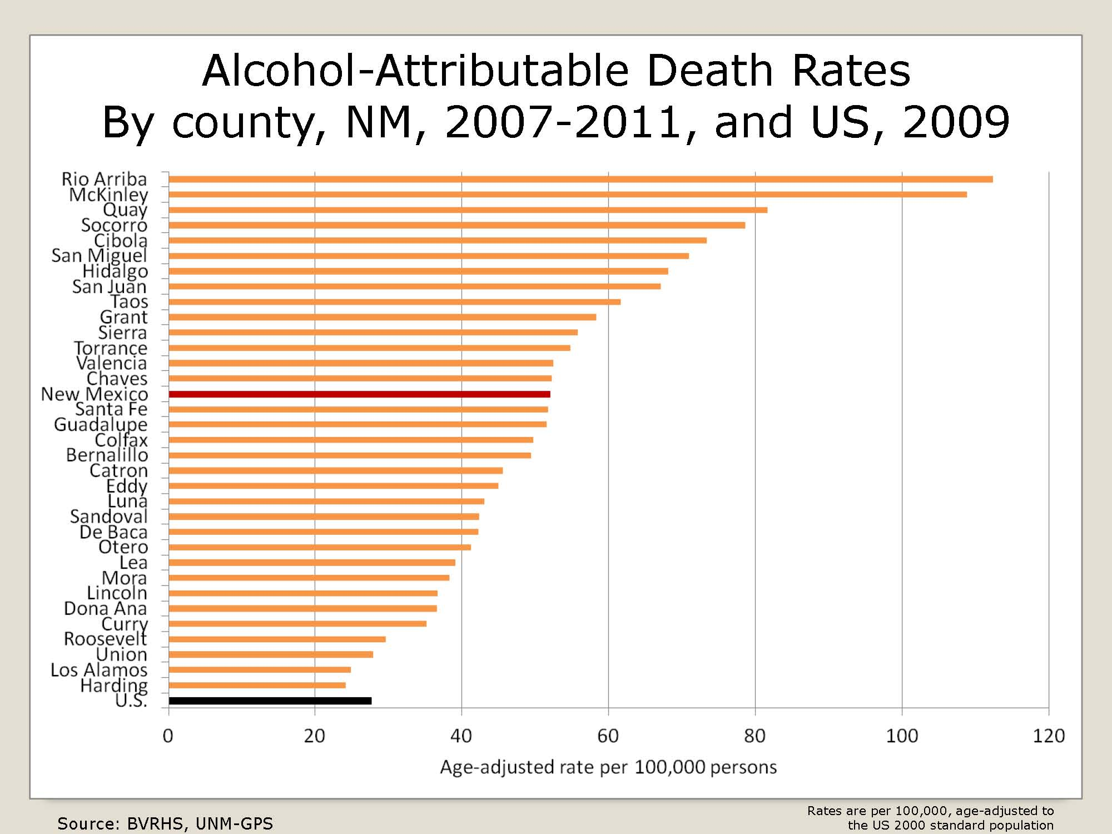
Alcohol Outlet Density: By County
Alcohol-attributable Death Rates By County
NM, 2007-2011, and US, 2009
Notes:
Age-adjustment is a statistical process applied to rates of disease, death, injuries or other health outcomes which allows communities with different age structures to be compared. Age confounding occurs when the two populations being compared have different age distributions and the risk of the disease or outcome varies across the age groups. The process of age-adjustment by the direct method changes the amount that each age group contributes to the overall rate in each community, so that the overall rates are based on the same age structure. Rates that are based on the same age distribution can be compared to each other without the presence of confounding by age. Adjustment is accomplished by first multiplying the age-specific rates of disease by age-specific weights. Refer to: http://www.health.ny.gov/diseases/chronic/ageadj.htm

Slide 15
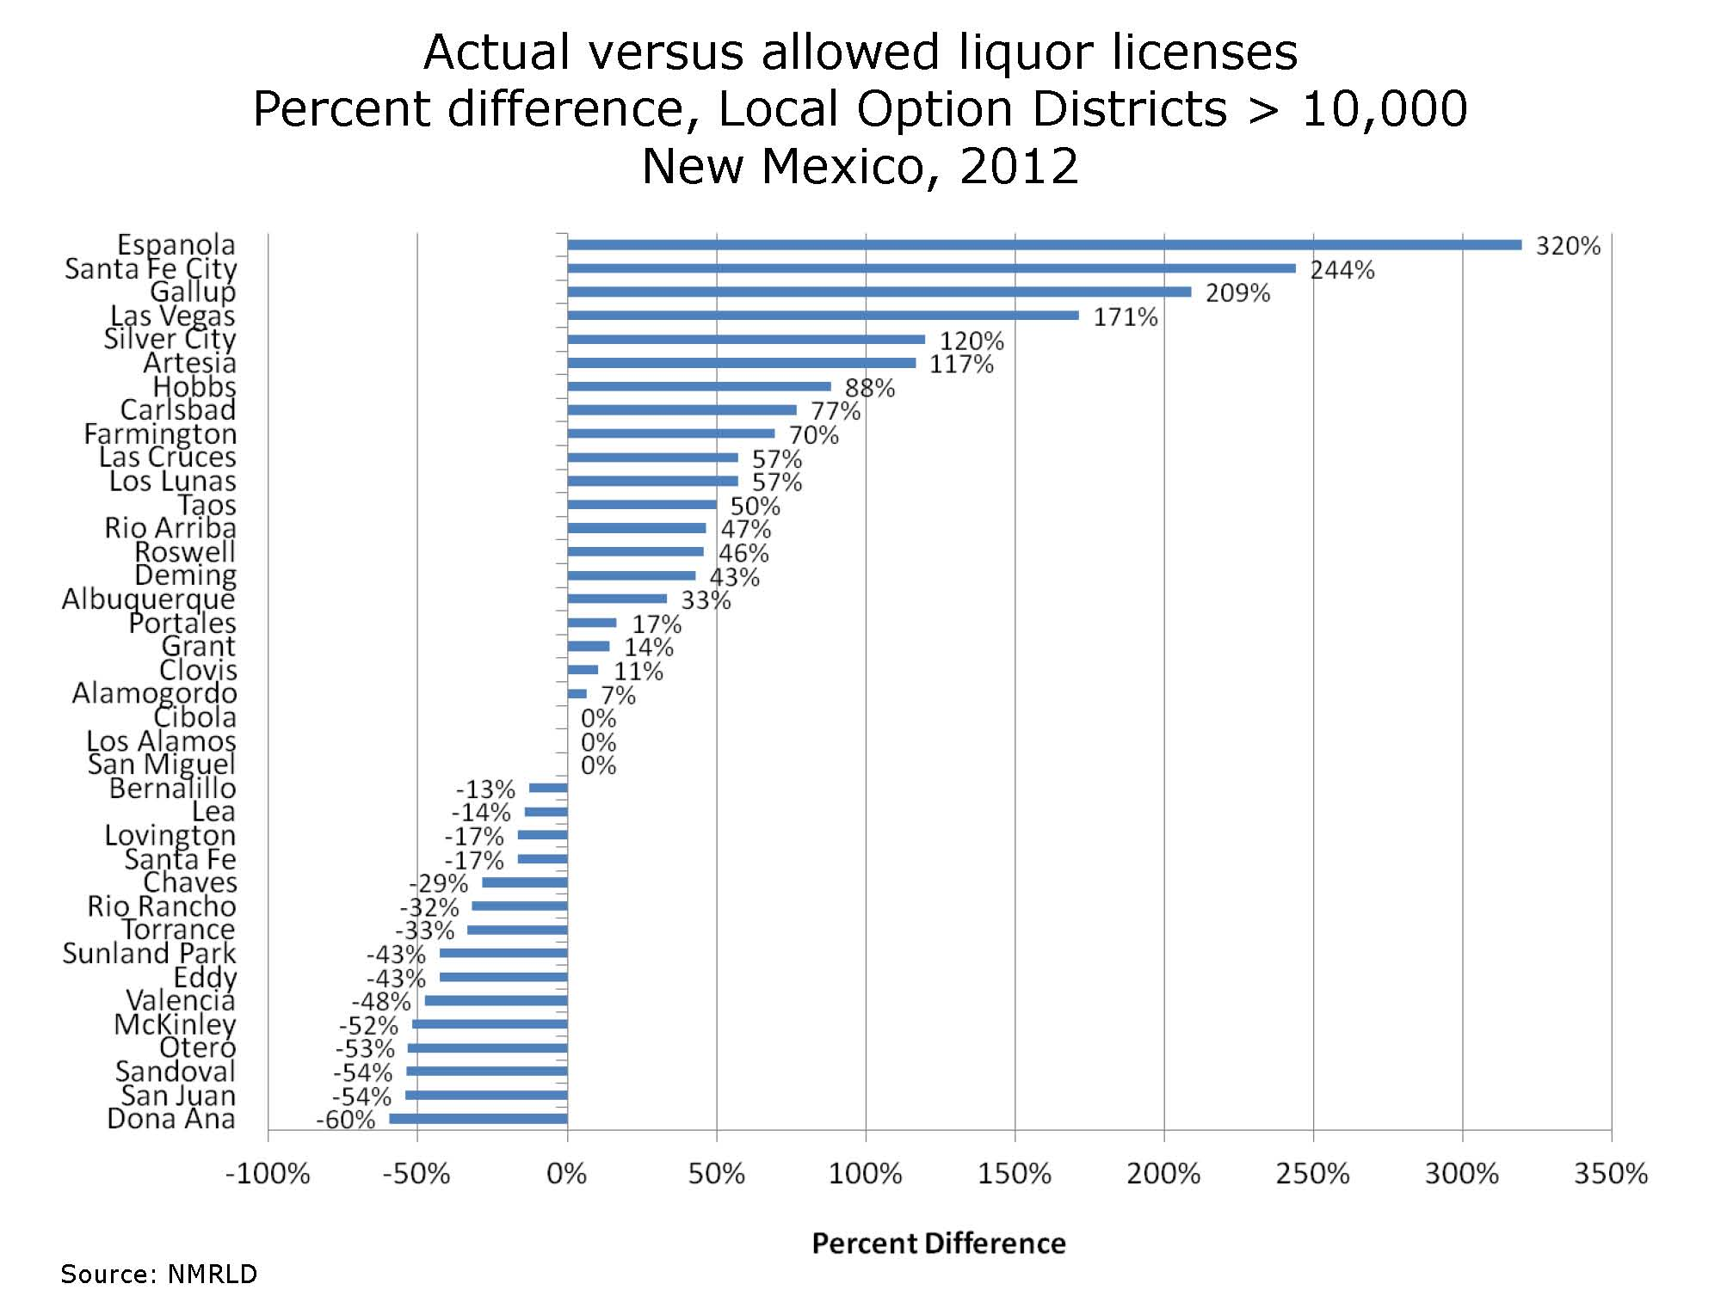
Alcohol Outlet Density: LOD
Actual Versus Allowed Liquor Licenses
Percent difference, local option districts < 10,000
New Mexico 2012
Notes:
NM RLD: New Mexico Regulations and Licensing Department
LOD: Local Option District

Slide 16
CALL TO ACTION: Build Capacity
Collect data on your community
Ratio of alcohol outlets to population
Alcohol related harms: DWI, underage drinking, violence, etc.
The economic impact of alcohol: Cost of alcohol abuse to NM
Local conditions
Share information with your community
DWI Planning Councils
County Health Councils
Neighborhood and Homeowner associations
Other related groups

Slide 17
CALL TO ACTION: Educate
Arrange small meetings with the AGD Director, Local Legislators and Elected Officials to discuss:
Alcohol Outlet Density impact
Concerns about sales to intoxicated persons
Economic cost of alcohol related harms
Your organization's role within the community
Local data and conditions in your community
Invite the AGD Director to come to your community and meet with your organization
Invite local legislators and elected officials to meet with your organization

Slide 18
CALL TO ACTION: Engagement
Attend Alcohol Server Education Advisory Committee
Purpose: Standardize guidelines for all alcohol server training ; online, classroom setting, and/or onsite
The advisory committee is comprised of state agencies, liquor industry, MADD National, and included prevention experts
Request to Join Liquor Control Act Task Force
Purpose: Align division rules and state statute
Created by Senate Memorial 77 and will convene in Fall 2013
The task force will include representatives from any other groups that may have an interest in amending the Liquor Control Act, including interested citizens; and organizations involved with alcohol abuse prevention and underage drinking prevention.
Notes:
As per SM77…task force will include representatives from any other groups that may have an interest in amending the Liquor Control Act, including the DWI resource center, mothers against drunk driving, the New Mexico municipal league and the New Mexico association of counties, as well as representatives from law enforcement, the special investigations division of the department of public safety, the alcohol and gaming division of the regulation and licensing department and interested citizens; and organizations involved with alcohol abuse prevention and underage drinking prevention.

Slide 19
CALL TO ACTION: Collaborate and Communicate
Join the Alcohol Outlet Density in New Mexico Work Team
Public health and prevention professionals addressing the impact of alcohol outlet density on the state and local level
Contact the Santa Fe Prevention Alliance:
Lisa Grace Giuffra at 505 231 2252 or LgGiuffra@gmail.com

Slide 20
RESOURCES & RESEARCH
NM Department of Health
Guide to Community Prevention Services
Preventing Excessive Alcohol Consumption: Regulation of Alcohol Outlet Density: The Effectiveness of Limiting Alcohol Outlet Density As a Means of Reducing Excessive Alcohol Consumption and Alcohol-Related Harms
CADCA (Community Anti-Drug Coalitions of America)
Regulating Alcohol Outlet Density: An Action Guide
John Hopkins School of Public Health
CDC: Using Public Health and Community Partnerships to Reduce Density of Alcohol Outlets
Alcohol Outlet Density and Public Health
Notes:
http://nmhealth.org/ERD/HealthData/hdata.shtml
http://nmhealth.org/ERD/HealthData/substance_abuse.shtml
http://www.thecommunityguide.org/alcohol/outletdensity.html
http://www.thecommunityguide.org/alcohol/EffectivenessLimitingAlcoholOutletDensityMeansReducingExcessiveAlcoholConsumptionAlcohol-RelatedHarms.pdf
CADCA Recourses: http://www.cadca.org/resources
GIS Mapping: http://mapping.cadca.org/
http://www.camy.org/action/outlet_density/_includes/outlet%20density%20strategizer_nov_2011.pdf
http://www.camy.org/
http://www.cdc.gov/pcd/issues/2013/12_0090.htm
http://alcoholjustice.org/images/stories/11MI0705_outletdensity_3.pdf

Slide 21
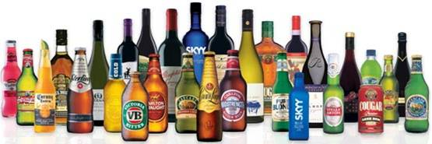
AGD Contact Information
Jennifer M. Anderson, Director
Alcohol and Gaming Division
505 476 4875
Jennifer.Anderson@state.nm.us
State of New Mexico Regulation & Licensing Department, Alcohol and Gaming Division
2550 Cerrillos Road
Santa Fe, NM 87505
http://www.rld.state.nm.us/alcoholandgaming/

Slide 22
What are your…
Next
Steps

