Slide 1
Adverse Childhood Experiences (ACE)
and Prevention Planning
August 13, 2013
Southwest Resource Team
SAMHSA’s Center for the Application of Prevention Technologies (CAPT)
Presenter:
Laura Porter, CAPT Associate
New Mexico Human Services Department

Slide 2
This training was developed under the Substance Abuse and Mental Health Services Administration’s (SAMHSA) Center for the Application of Prevention Technologies contract. Reference # HHSS277200800004C.
For training use only.

Slide 3
Audience
Substance Abuse Prevention and Treatment (SAPT) Block Grant and Partnership for Success (PFS) II sub-recipients
State-level staff
Other prevention stakeholders from New Mexico

Slide 4
Presenter
Laura Porter is co-founder of ACE-Interface and also serves as the Director of ACE Partnerships for Washington State’s largest agency: the Department of social and Health Services. She works with state managers and community leaders to embed ACE study findings and related neuroscience and resilience findings into policy, practice and community norms.

Slide 5
Learning Objectives
Understand the links between ACE data and substance abuse prevention
Describe examples of how to use state-specific ACE data to inform substance abuse prevention strategy implementation at state and local levels

Slide 6
Think, Pair, Share
What is your name?
What did you leave behind to be here today?
If you could paint a picture of stunning prevention success, what would your painting look like (e.g., colors, shapes, light)?

Slide 7
Building A Common Platform for Transformative Action
Developmental neurobiology
Adverse Childhood Experience
Resilience

Slide 8
Terms We’ll Use Today
Toxic stress
Adverse Childhood Experiences (ACE)
Complex trauma

Slide 9
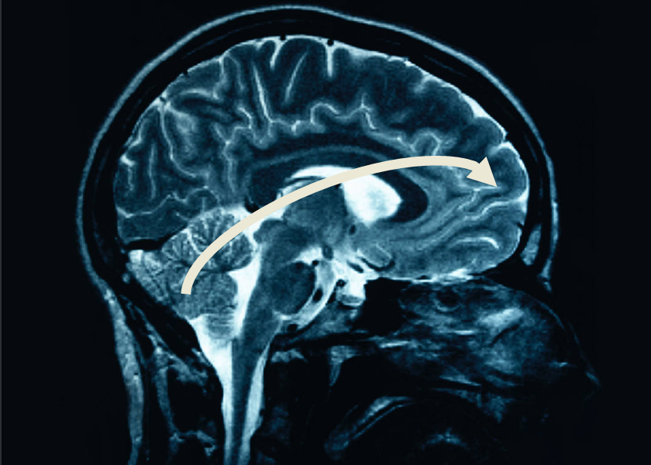
Neuroscience and the Effects of Toxic Stress
Notes:
Brain Development is Sequential
Key Variables in Brain Outcomes:
Experience, Gender, Age

Slide 10
Hardwired for Anticipated World
  Brain Development
  for Dangerous World
INDIVIDUAL
“Brawn over Brains”
Focused: Fight, Flight or Freeze
OUTCOME
Individual & species survive the worst conditions
TOXIC STRESS
Dissonance between biological expectations & social reality fuels problems
NEUTRAL START
BRAIN
Prepares for anticipated world
  Brain Development
  for Safe World
INDIVIDUAL
”Process over Power”
Multi-focused: Relational
OUTCOME
Individual & species survive in good times; vulnerable in poor conditions
Adapted from the research of Martin Teicher, MD, Ph.D
By Washington Family Policy Council
Notes:
We all start with a brain that will adjust.
The top line is what happens when life is tough. In this case, traumatic stress means any condition that causes the stress hormones to be elevated for protracted periods of time. If our early experience includes danger or trauma, then chemicals are release that act on our cells, brain chemicals and other essential systems. We adapt to be quick to anger, quick to act and very tough. This requires brawn over brains…take what you need, ask questions later. And frankly, individuals and the species will do much better in times of trouble if this is how we behave.
On the other hand, if early experience is warm, friendly, kind and loving, then our brains are bathed in soothing, happy hormones and we grow up relationship-oriented, willing and able to share, and be patient. We value process over power. And that’s great for a world where everyone gets along, shares and strives for peace. The species wouldn’t do very well in times of trouble—like war, famine or other threats to survival—if we all had these characteristics.
We’re only really made to be under stress for about 20 minutes at a time. So experiences like child abuse, neglect or even being in a war zone or a famine cause our stress hormones to be continuously produced. Our bodies prepare for a tough life in a dangerous world. Stress hormones exert influence on cells, chemicals and wiring. They develop brains that are wired for certain characteristics – like being edgy, hot tempered, impulsive and hyper vigilant. This is the path outlined on the top line of the slide. For example, people who have had traumatic stress from conception to the toddler years will likely have a higher baseline of the stress hormones like cortisol in their bodies. As a result, these folks may have a very short fuse and a difficult time calming themselves. If there is more danger just around the corner, rapid calming wouldn’t contribute to survival—readiness for a next danger would.
One strong mental model in our society is that the people whose experience takes them on the top path are maladaptive and the people along the bottom path are adaptive. That’s untrue…both pathways are adaptive. Both brains are adapting to their experience. And that’s good for us as a species because the people whose brains are made for a malevolent world help us survive when life is tough and the people whose brains are wired for a benevolent world help our species survive in calm and happy times. Our experiences get wired into our biology.
Dr. Teicher says it’s when our biology collides with social expectations that we run into trouble. A child from the top path is not going to sit still—sitting still is a “sitting duck”. He or she is not going to share, cooperate or use words as their first choice. When that child comes to school and we ask them to sit still, share, cooperate, etc, there is a painful disconnect that can be very hard for everyone. Likewise, if you put a person from the benevolent world into the dog-eat-dog competition of say, Wall Street, that person is going to struggle. It’s the context we end up in that determines how functional our adaptations really are.
We can’t change people’s biology—or at least we don’t know how to do that yet. But we can teach skills. For example, we do teach girls who are very trusting and relationship oriented to keep themselves safe. We teach self defense and other common sense tools. We may want to think about whether we can teach tools to individuals on the top path way, too. Is there a way to take “impulsive” and add skills so that the individual is a very decisive and capable leader, who is able to act quickly with limited information? What might it take to accomplish that?

Slide 11

Each Person: A Unique Experience of the World

Slide 12
Reflection
How do our major social, health, education, and justice systems respond to people with “brawn over brain” responses to stress?

Slide 13
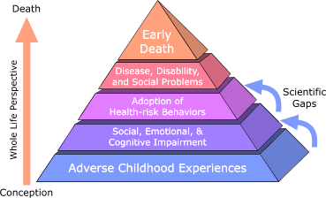
Adverse Childhood Experience Study
The Adverse Childhood Experiences Study, http://acestudy.org/
Notes:
Largest Study of its Kind
Over 17,000 participants
Both Retrospective and Prospective
Over 100 Peer-Reviewed Journal Articles
We have been talking about neuroscience research – which is the study of individuals. Now we are going to switch gears and talk about the population as a whole. It can be challenging to think about how the whole population is affected by a disease agent – but when we are interested in transformational change – really finding high leverage solutions to problems, then we need to think about what would produce population-level improvements. So, we’ll turn to the field of epidemiology.
When Dr. Rob Anda and Dr. Vincent Felitti designed the ACE Study, they were testing a theory about pathways to disease. They were studying disease agents that would change the way we think about preventive action. They thought about the impact of life experiences during childhood on human development and how health changes over the lifespan. They used a life-span perspective to develop this theoretical model for learning about foundations of health, safety, and long life.
Their theory was that adverse childhood experience leads to social, emotional, cognitive impairment, which leads to adoptions of risk behaviors, which leads to disease and early death. They designed the ACE study to determine whether or not adverse childhood experience could be an underlying cause of a portion of diseases experienced in the population.
Prior to this work Dr. Anda had been a leader in the field of reducing heart disease. His work through the 80s and into the 90s, was about identifying risk and protective factors that predicted heart disease, and working to reduce the risk and increase the protective factors. You all will recognize this risk and protective model – it has been the prevailing model for prevention in many fields during our lives. But, Dr. Anda knew that risk for heart disease as will as risk for many mental, physical, and behavioral disorders is not randomly distributed – and therefore could not be the underlying cause of the health problems he was dedicated to resolving. Prior to the ACE study, Dr Anda won many prestigious awards for his work leading primary, secondary and tertiary disease reduction strategies using a risk and protection factor approach, but he left that behind in order to find underlying causes of ill-health.
This pioneering and courageous work by Drs. Felitti and Anda uncovered evidence of the most powerful determinate of the public’s health. It also challenged long held beliefs about pathways to disease and theories about how best to interrupt them. The work was, at first, controversial. Now, it leads strategy at the World Health Organization, many federal agencies, and here in Washington – in state agencies and in communities throughout the state.

Slide 14
ACE Categories are Interrelated
Abuse:
Child physical abuse
Child sexual abuse
Child emotional abuse
Neglect:
Physical neglect
Emotional neglect
Notes:
87%
with 1 ACE
have another
The Adverse Childhood Experience categories that Drs Anda and Felitti included in their study include :
Three forms of abuse: physical, emotional, and sexual abuse
Two kinds of neglect: physical and emotional neglect and
Five indicators of household functioning: having a mentally ill, depressed or suicidal person in the home, having a drug addicted or alcoholic family member, incarceration of a family member, loss of a parent, and witnessing violence against one’s mother.
The researchers did ask about severity of abuse, duration and other kinds of questions that are important to folks working in child safety. But when it comes to health outcomes, they found that what matters most in terms of life-long health is the number of different kinds of adverse childhood experiences. When lots of different categories stack up in a person’s life, the cumulative effective is stunning.
And, these different kinds of experiences do typically come in clusters – among people who said that they had one category of Adverse Childhood Experience, 87% had at least one more category of Adverse Childhood Experience. So, the researchers said “It doesn’t make sense to make a study about the 13% who don’t have additional ACEs, it makes more sense to have the study be about the 87% of people who did experience multiple ACE categories.
That’s why they made an ACE score – which you will see throughout the rest of this presentation. The ACE Score is the number of different categories of Adverse Experience during a person’s childhood – from 1-10.

Slide 15
ACE Categories are Interrelated
Indicators of Family Dysfunction:
Mentally ill, depressed or suicidal person in home
Drug addicted or alcoholic family member
Parental discord – indicated by divorce, separation, abandonment
Witnessing domestic violence against the mother
Incarceration of any family member

Slide 16
Data Collection Methods – New Mexico
ACE module of the Behavioral Risk Factor Surveillance System (BRFSS) collected in 2009
Telephone survey of randomly selected adults aged 18 years and older
5,271 New Mexicans surveyed
Eleven questions yielding eight categories of ACE referring to the time before they were aged 18 years
Adverse Childhood Experiences Report by Adults --- Five States, MMWR, December 17, 2010 / 59(49);1609-1613.

Slide 17
Percent of New Mexico adults* aged >18 years reporting an ACE, by number of ACE reported
*n=5,271
Adverse Childhood Experiences Report by Adults --- Five States, MMWR, December 17, 2010 / 59(49);1609-1613.

Slide 18
New Mexico Adults 4+ ACE
    Compared to persons with 0 ACE, New Mexico residents with >4 ACE were more likely to report:
    Fair/Poor Health (21.6% vs. 15.4%)
    Smoking (33.6% vs. 12.6%)
    Injury (50.3% vs. 26.6%)
Laura Tomedi, New Mexico Behavioral Risk Factor Surveillance System, 2009. New Mexico Department of Health. Prepared June 7, 2012.

Slide 19
New Mexico adults with 4+ ACE are more likely to have problems:
Poor mental health
Asthma
Binge drinking
Heavy drinking
No health insurance
Laura Tomedi, New Mexico Behavioral Risk Factor Surveillance System, 2009. New Mexico Department of Health. Prepared June 7, 2012.

Slide 20
Percent of New Mexico adults aged > 18 years reporting an ACE, BRFSS 2009
*n=5,271 (randomly selected New Mexico residents).
**n=26,229 (includes randomly selected residents from Arkansas, Louisiana, New Mexico, Tennessee, and Washington).
Adverse Childhood Experiences Report by Adults --- Five States, MMWR, December 17, 2010 / 59(49);1609-1613.

Slide 21
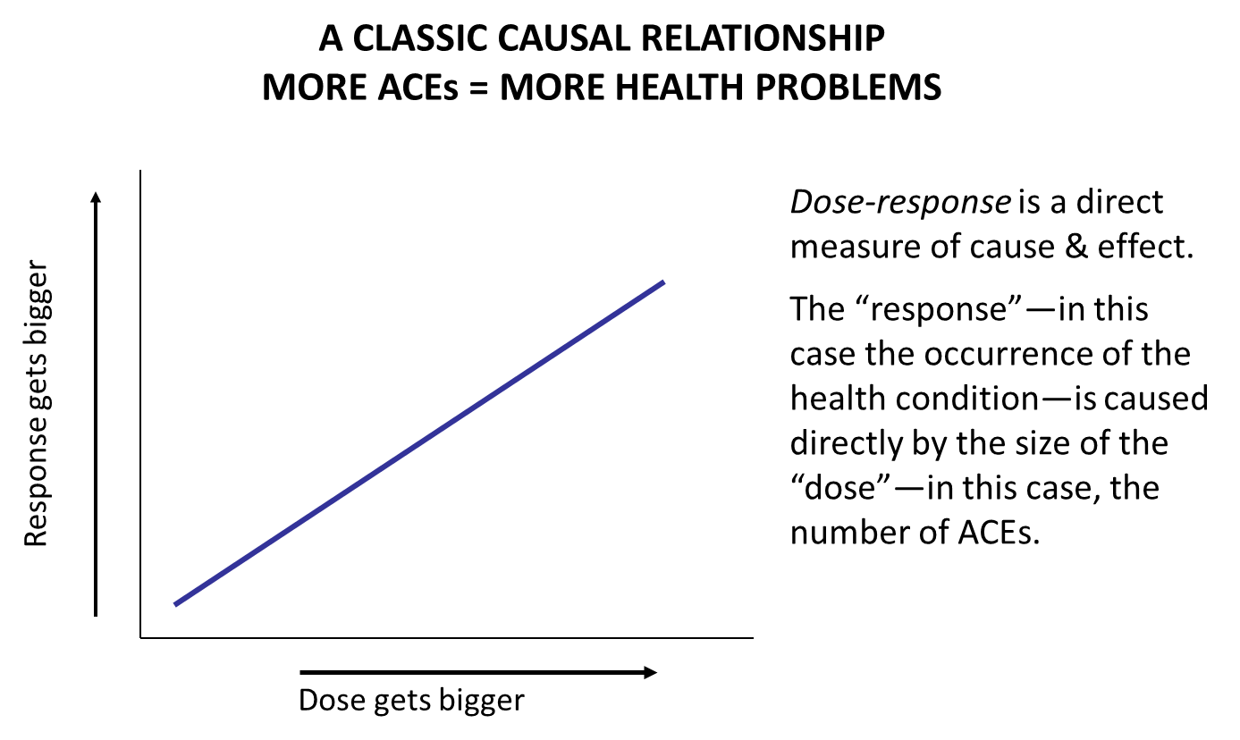
Dose - Response
A Classic Causal Relationship
More ACE = More Health Problems
Dose-response is a direct measure of cause & effect.
The “response”—in this case the occurrence of the health condition—is caused directly by the size of the “dose”—in this case, the number of ACE.

Slide 22
Current Smokers and History of Adverse Childhood Experience, New Mexico Residents
Laura Tomedi. (June 7, 2012) New Mexico Behavioral Risk Factor Surveillance System, 2009. New Mexico Department of Health..

Slide 23
Ever Had a Drug Problem
Dube, S. R., Felitti, V. J., Dong, M., Chapman, D. P., Giles, W. H., & Anda, R. F. (2003). Childhood abuse, neglect and household dysfunction and the risk of illicit drug use: The Averse Childhood Experience Study. Pediatrics , 111(3), 564–572.

Slide 24
Alcohol: Age at First Use
ACE Score
Dube, S. R., Miller, J. W., Brown, D. W., Giles, W. H., Felitti, V. J., Dong, M., & Anda, R. F. (2006). Adverse childhood experiences and the association with ever using alcohol and initiating alcohol use during adolescence. Journal of Adolescent Health, 38(4), 444.
Notes:
Research has demonstrated a strong graded relationship between ACES and initiation of drug use. Here you see adverse childhood experiences grouped from 0 to four or more. As the number of adverse childhood experiences increases, the initiation of alcohol use before the age of fourteen also increases. 4% of participants with no adverse childhood engaged in alcohol use compared to 16.9% for those who experienced 4 or more ACES. A similar relationship is observed when looking at drinking initiation between the ages of 14 and 17, but the result is not as strong.
For our states, tribes and jurisdictions focusing on underage drinking these results should be alarming and suggest the importance of addressing ACEs as one component of preventing underage drinking.
According to the study authors, responses to underage drinking will not be effective unless they help youth recognize and cope with stressors of abuse, domestic violence and other adverse experiences.
Given the negative impact of early initiation of alcohol use on neurodevelopment and the evidence that adverse child events also impact neurodevelopment, these findings are concerning.
Added Neglect (CTQ)
Attributable Risk Fraction (ARF) for early initiation of alcohol use was 55%
Influence on initiation persisted for 4 birth cohorts dating back to 1900.

Slide 25
Smoking: Age at First Use
Anda, R. F., Croft, J. B., Felitti, V. J., Nordenberg, D., Giles, W. H., Williamson, D. F., & Giovino, G. A. (1999). Adverse childhood experiences and smoking during adolescence and adulthood. Journal of the American Medical Association, 282, 1652–1658.
Notes:
As with alcohol use, ACEs increase the likelihood of early smoking initiation (before 18) with 21% of those with 4 or more ACES reporting early initiation of smoking compared to only 5.5% with no ACES. Moreover, ACEs lead to continued smoking, heavy smoking and while not shown here, the risk of Chronic Obstructive Pulmonary Disease (COPD).
OR controlled for sex, age, race, education. P value for trend all signficant P<.001.
Early initiation (before 18 years)
Heavy smoking (>= 1 pack / day)

Slide 26
Illicit Drug Use: Age at First Use
Dube, S. R., Felitti, V. J., Dong, M., Chapman, D. P., Giles, W. H., & Anda, R. F. (2003). Childhood abuse, neglect and household dysfunction and the risk of illicit drug use: The Averse Childhood Experience Study. Pediatrics , 111(3), 564–572.
Notes:
Another analysis looked at iniation of illicit drug use before the age of 14 and between 14 and 18. Again, the graded relationship is observed with more ACES associated with greater likelihood of illicit drug use initiation…

Slide 27
Anda, R., & Brown, D. (2010, July 2). Adverse Childhood Experience & Population Health in Washington. Family Policy Council-Community Networks. Retrieved August 9, 2012, from www.fpc.wa.gov/publications/ACEs%20in%20Wa

Slide 28
Anda, R., & Brown, D. (2010, July 2). Adverse Childhood Experience & Population Health in Washington. Family Policy Council-Community Networks. Retrieved August 9, 2012, from www.fpc.wa.gov/publications/ACEs%20in%20Wa

Slide 29
Suicide Attempts
Dube, S. R., Anda, R. F., Felitti, V. J., Chapman, D., Williamson, D. F., & Giles, W. H. (2001). Childhood abuse, household dysfunction and the risk of attempted suicide throughout the life span: Findings from Adverse Childhood Experiences Study. Journal of the American Medical Association, 286, 3089–3096.
Notes:
ACEs have a powerful graded relationship to the risk of suicide attempts; this holds for attempts by men and women and attempts during adolescence or adulthood. This graph shows the proportion of child and adolescent attempts in blue and adult attempts in orange. Again extremely high prevalence of attempted suicide with high ACE scores.
Corresponding OR adjusted for sex, race, education level,age
Chi Square test for trend significant for both groups
Strong influence of childhood trauma on past and future suicide attempts among incarcerated women persisted even after controlling for substance abuse and emotional distress.”

Slide 30
Outcomes Associated with High ACE Scores - Washington
Prevalent disease
Risk factors for common diseases/poor health (including substance abuse)
Poor mental health
General health and social problems
Risk for intergenerational transmission of ACE

Slide 31
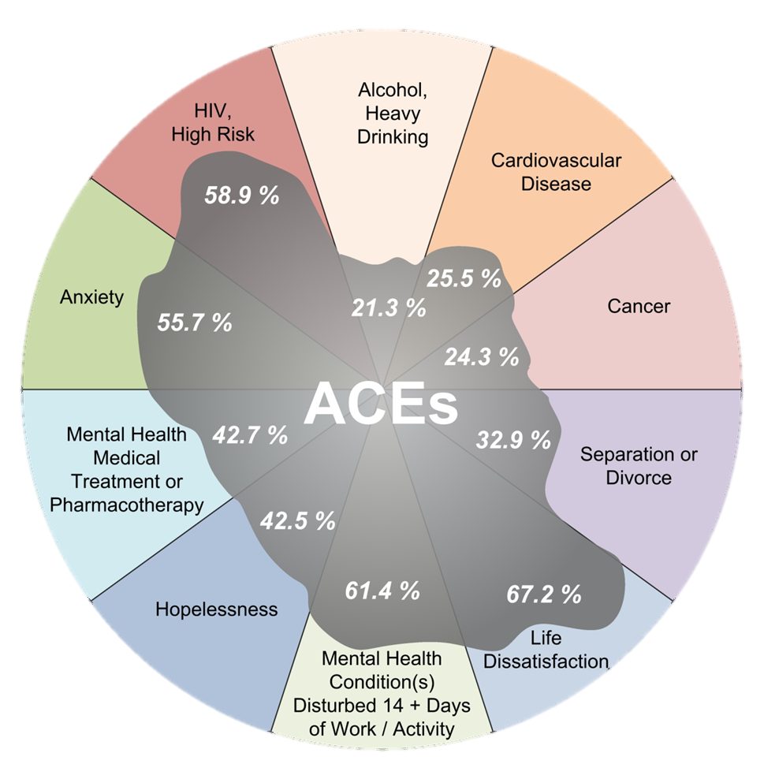
Data from: ACE & Population Health in Washington; Anda & Brown; 2009
Notes:
ACE reduction reliably predicts simultaneous decrease in all of these conditions.
Population attributable risk

Slide 32
“What’s predictable is preventable.”
Dr. Robert Anda
How do we move
from prediction to prevention?

Slide 33

Concepts of Resiliency
Notes:
Resilience is the ability to “meet challenges, survive and do well despite adversity” –Kirmayer, 2009

Slide 34
Capabilities can be impacted by trauma.
Capability

Slide 35
Capability
Attachment & Belonging

Slide 36
Capability
Attachment & Belonging
Community, Culture, Spirituality

Slide 37
Compassion Exercise
Notes:
COMPASSION EXERCISE (30 minutes) (LAURIE)
Please divide into groups of five. You will be given a list of toxic stress effects that people can face and assigned a population. Choose three of the effects and look specifically at how these three would negatively affect the daily lives of your population, as well as what kinds of accommodations might help. You will post your answers as you leave for lunch
Materials:
Sticky notes

Slide 38
Think & Write on Your Own…
Review list of populations – choose one
Review the list of enduring effects
Pick three “effects” that you think are particularly relevant to your selected population. How would these effects make success more difficult? How might environment or relationships help or hinder the effects?
Write on a sticky: Population, Three Effects.

Slide 39
Share in your small group
Which population with which effects did you select?
How might those effects “show up” in an individual?
What actions, if you took them, might help the individuals or groups address the effects?

Slide 40
Post
As you go to lunch, post your sticky note with population and three effects.

Slide 41
Lunch Break

Slide 42
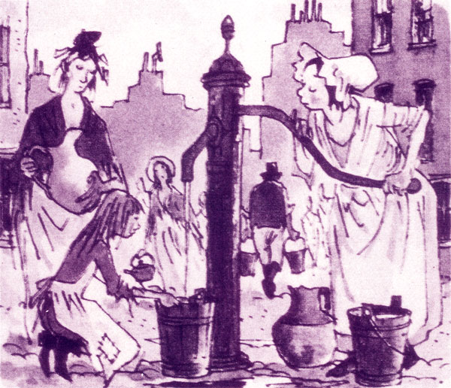
Dr. John Snow - 1854
Cholera Death is Caused by Miasmas
New Way of Thinking
Shoe Leather Epidemiology
Lives Saved
Notes:
Within ten days, the number of deaths from cholera exceeded five hundred.
Foul odors was theory of the day
Tell everyone
MM shift – people begin to drink out of different pump
Cooperate to make a system that works – prefigurative action
Begin to construct new infrastructure
Lives improve
Consistent with values of society

Slide 43
Life Course Approach
The Adverse Childhood Experiences Study, http://acestudy.org/
Notes:
Largest Study of its Kind; Over 17,000 participants; Both Retrospective and Prospective; Over 100 Peer-Reviewed Journal Articles
Shifting the Paradigm:
Helps Us Understand Drivers of Population Health and Wellbeing
We have been talking about neuroscience research – which is the study of individuals. Now we are going to switch gears and talk about the population as a whole. It can be challenging to think about how the whole population is affected by a disease agent – but when we are interested in transformational change – really finding high leverage solutions to problems, then we need to think about what would produce population-level improvements. So, we’ll turn to the field of epidemiology.
When Dr. Rob Anda and Dr. Vincent Felitti designed the ACE Study, they were testing a theory about pathways to disease. They were studying disease agents that would change the way we think about preventive action. They thought about the impact of life experiences during childhood on human development and how health changes over the lifespan. They used a life-span perspective to develop this theoretical model for learning about foundations of health, safety, and long life.
Their theory was that adverse childhood experience leads to social, emotional, cognitive impairment, which leads to adoptions of risk behaviors, which leads to disease and early death. They designed the ACE study to determine whether or not adverse childhood experience could be an underlying cause of a portion of diseases experienced in the population.
Prior to this work Dr. Anda had been a leader in the field of reducing heart disease. His work through the 80s and into the 90s, was about identifying risk and protective factors that predicted heart disease, and working to reduce the risk and increase the protective factors. You all will recognize this risk and protective model – it has been the prevailing model for prevention in many fields during our lives. But, Dr. Anda knew that risk for heart disease as will as risk for many mental, physical, and behavioral disorders is not randomly distributed – and therefore could not be the underlying cause of the health problems he was dedicated to resolving. Prior to the ACE study, Dr Anda won many prestigious awards for his work leading primary, secondary and tertiary disease reduction strategies using a risk and protection factor approach, but he left that behind in order to find underlying causes of ill-health.
This pioneering and courageous work by Drs. Felitti and Anda uncovered evidence of the most powerful determinate of the public’s health. It also challenged long held beliefs about pathways to disease and theories about how best to interrupt them. The work was, at first, controversial. Now, it leads strategy at the World Health Organization, many federal agencies, and here in Washington – in state agencies and in communities throughout the state.
The Adverse Childhood Experience categories that Drs Anda and Felitti included in their study include :
Three forms of abuse: physical, emotional, and sexual abuse
Two kinds of neglect: physical and emotional neglect and
Five indicators of household functioning: having a mentally ill, depressed or suicidal person in the home, having a drug addicted or alcoholic family member, incarceration of a family member, loss of a parent, and witnessing violence against one’s mother.
The researchers did ask about severity of abuse, duration and other kinds of questions that are important to folks working in child safety. But when it comes to health outcomes, they found that what matters most in terms of life-long health is the number of different kinds of adverse childhood experiences. When lots of different categories stack up in a person’s life, the cumulative effective is stunning.
And, these different kinds of experiences do typically come in clusters – among people who said that they had one category of Adverse Childhood Experience, 87% had at least one more category of Adverse Childhood Experience. So, the researchers said “It doesn’t make sense to make a study about the 13% who don’t have additional ACEs, it makes more sense to have the study be about the 87% of people who did experience multiple ACE categories.
That’s why they made an ACE score – which you will see throughout the rest of this presentation. The ACE Score is the number of different categories of Adverse Experience during a person’s childhood – from 1-10.

Slide 44

High-Leverage Solutions
Moderate ACE Effects
Among Parenting Adults:
Build on Strengths; Improve Functioning & Coping
Prevent ACE Accumulation in Next Gen.
8
7
2
Virtuous Cycle

Slide 45
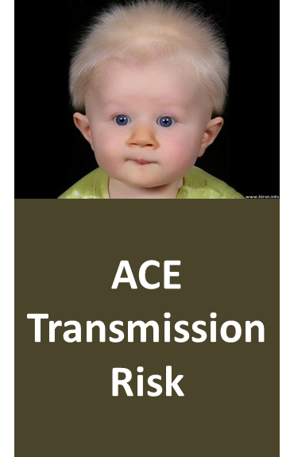
Historic Trauma
Adverse Childhood Experiences
Adverse Peer/School Experience
Adverse Adult Experience
Multiple Mental, Physical, Relational, and/or Productivity Problems

Slide 46
ACE and Adult History of Homelessness
Longhi, D., Silveanu, A., & Porter, L. (2012, February 1). Stress, Strength, Work, Hope. Family Policy Council - Community Networks. Retrieved August 9, 2013, from www.fpc.wa.gov/publications/StressStrengthWorkHope.VR-Data-Report.pdf
Notes:
Documentation/notes for
Two charts on ACEs and History of Homelessness since the Age of 18
General Washington State Adult Population
Source: Washington State 2010 BRFSS: n = 5,960 - representing 5.1 million adults
Total Result: 5.6 % adults (18 year old or more) had a history of homelessness -
They represent 290,000 Washington State adults
Number of ACEs: 0 1 2 3 4-5 6-8
% of total adults: 37.4 21.9 13.7 9.8 12.0 5.2
N of adults in thousands: 1,926 1,128 705 505 618 268
Sample sizes: n= 2,313 1,345 811 528 673 290
25-54 Year Old Adults in Washington State
Source: Washington State 2010 BRFSS: n = 2,260 - representing 2.8 million adults
Total Result: 7.9 % adults 25-54 year old had a history of homelessness since the age of 18 – They represent 225,000 Washington State adults
Number of ACEs: 0 1 2 3 4-5 6-8
% of total adults: 33.8 22.0 13.8 9.8 13.9 6.7
N of adults in thousands: 1,926 1,128 705 505 618 268
Sample sizes: n= 958 624 391 275 394 190
Tables drawn from:
H:\BRFSS\2010\homeless\preliminary homeless frequencies and ACEs 8_30_2011.spv
Dr. Dario Longhi, Ph. D. 9-30-11

Slide 47
ACE and Ability to Engage in Work/Life Activities
Longhi, D., Silveanu, A., & Porter, L. (2012, February 1). Stress, Strength, Work, Hope. Family Policy Council - Community Networks. Retrieved August 9, 2013, from www.fpc.wa.gov/publications/StressStrengthWorkHope.VR-Data-Report.pdf
Notes:
ACEs are also drivers of one of the most important factors for success in school and success at work: showing up. Here we can see the impact of higher ACE score on people missing work due to physical or mental health challenges.
Among people with an ACE score of zero, only 4 percent missed 10 days of work in the month before the survey. That would be two full weeks of work missed. Whereas one out of five people with an ACE score of six or more missed ten or more days of work.
Also Attributable to ACEs:
Worker Injury
Work-related Illness
Drugs/Alcohol
Hopelessness
Health Limits Activity
Serious Job Problems
Serious Financial Problems

Slide 48
Disability-Related Days When Can’t Do Usual Activities
Longhi, D., Silveanu, A., & Porter, L. (2012, February 1). Stress, Strength, Work, Hope. Family Policy Council - Community Networks. Retrieved August 9, 2013, from www.fpc.wa.gov/publications/StressStrengthWorkHope.VR-Data-Report.pdf

Slide 49
Cascade Effect: Difficulty with Daily Functioning
Major Stress Categories:
  Homelessness
  Incarceration
  Chronic illness
  Separation/divorce
  Severe depression
  Work-related injury/illness
Longhi, D., Silveanu, A., & Porter, L. (2012, February 1). Stress, Strength, Work, Hope. Family Policy Council - Community Networks. Retrieved August 9, 2013, from www.fpc.wa.gov/publications/StressStrengthWorkHope.VR-Data-Report.pdf
Notes:
Adult adverse experience interacts with the impacts of Adverse Childhood Experience.
The combination results in more complex symptoms, which are reflected in increased disability score. This chart provides information about adults with 3 or more ACEs. Having a higher ACE score increases the likelihood of adult adversities, including the categories considered in this chart
Homelessness
Incarceration
Chronic illness
Separation/Divorce
Severe Depression
Work-related Injury/ Illness
adversity Eighty percent (80%) of the population of adults who have a high ACE score plus a large number of categories report interruption in their ability to do their usual activities, including work for one or more days a month. Forty percent (40%) report disability-related interruption to their daily activities for 14 to 29 days a month (Moderate Disability Score).

Slide 50
Longhi, D., Silveanu, A., & Porter, L. (2012, February 1). Stress, Strength, Work, Hope. Family Policy Council - Community Networks. Retrieved August 9, 2013, from www.fpc.wa.gov/publications/StressStrengthWorkHope.VR-Data-Report.pdf

Slide 51

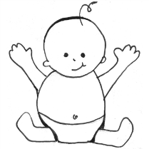
Elementary Children
Greatest single predictor for health, attendance, behavior
Second strongest predictor for academic failure
Christopher Blodgett, WSU AHEC Spokane, WA; Personal Communication with Laura Porter; 2012

Slide 52
Among youth with ≥4 ACE:
  33% of court involved youth re-offend in two years (vs. 13% 0-1 ACE)
  51% in special Ed. (vs. 33% 0-1 ACE)
  74% below 2.0 GPA (vs. 58% 0-1 ACE)
  64% 4+ suspensions
  85% suspended by 2nd grade
Grevstad, J. & Anda, R.; Adverse Childhood Experience in Adjudicated Youth in Washington; 2010; Report to Washington Family Policy Council

Slide 53
Adult Adversity:
Incarceration
Victim of interpersonal violence
Drug/alcohol Problems
Mental illness
Divorce
Work injury- illness
Homelessness
Disability
Poverty
Health limits activity
Unemployment
Longhi, Porter & Silveanu; Stress, Strength, Work, Hope; 2012

Slide 54
Parenting Adults:
Parents with ≥5 ACE are 14 X more likely to have 2 or more conditions that make ACE for kids
Simmons, K. & Porter, L.; Analysis of 2010-2011 Washington BRFSS data; unpublished

Slide 55
Elements of Executive Function
Response inhibition 7
Working memory7
Emotional control8
Flexibility11
Sustained attention9
Task Initiation7
Planning and prioritizing12
Organization5
Time management9
Goal-directed persistence1
Metacognition18
Guare and Dawson 2013, pp. 42-43

Slide 56
How Neurobiology Informs Change
Perception of threat: safe harbor
Verbal memory: corrections officer training

Slide 57
What Helps Individuals Self-regulate?
Massage
Mindfulness, reflection
Pleasure
Biofeedback
Movement and music
Exercise and play
Activities that integrate visual information with fine- and gross-motor movements
Physical activities for exploration of environment.
Practicing connection

Slide 58
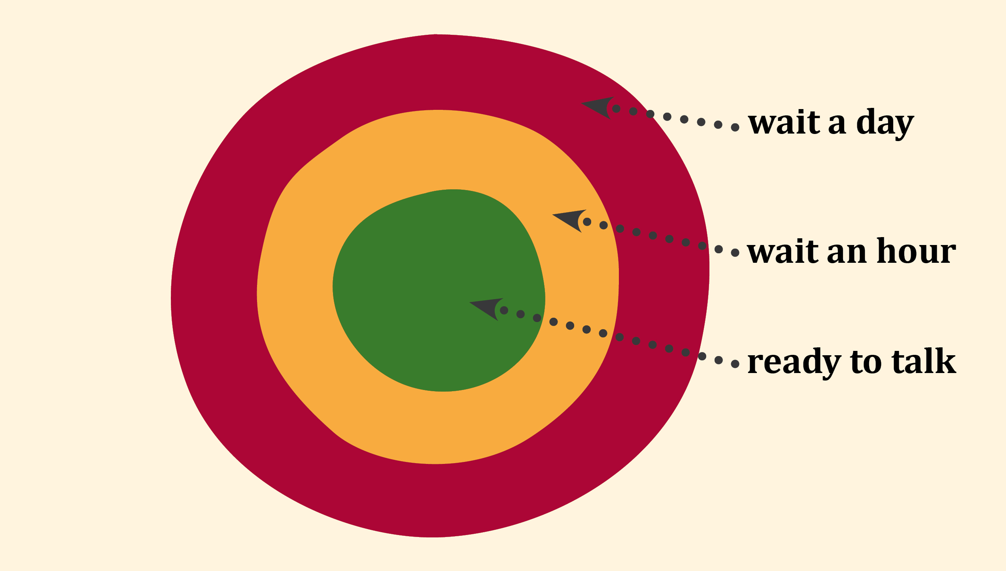
Identifying Emotional States
©2013
Notes:
One alternative high school principal, after learning that some people are not biologically wired to be rational at the same time they are emotionally triggered, developed a new discipline process that has dramatically reduced problems in his school.
He made a simple graphic of a green-yellow-red colored target, with green in the center and red as the outer band. Adults and teens alike always identify their emotional state before any disciplinary conversation can begin. If either person is “in the red” – they wait hours or even a day before they begin to talk about what went wrong and what should be done about it. Once teens have calmed, they can be active partners in taking care of the school, taking care of one another and taking care of themselves.
As we learn more about how trauma is hard-wired into biology, we can begin to challenge old assumptions and develop accommodations – like the simple target -- that help people participate more fully in community life.

Slide 59
How ACE Information Informs Change
Transitions from preschool to kindergarten
Better treatment fit for adjudicated youth
ACE are common; work in universal systems
High ACE parents become powerful leaders of next generation ACE reduction

Slide 60
Resilience Occurs at All Levels
Individual
Family & Friends
National, Global, Ecosystem
Community
Notes:
This slide was in the wrong place… needs to have new thinking about how to use in this talk……
Resilience is a term that comes from the physics of materials. In that context it means the ability to return to original form after having been bent or compressed. For example, bamboo is considered to be resilient because the plant can be bent to the ground, but will spring back, grow well, and be essentially unchanged.
But human beings aren’t just materials that can spring back to original form or function after significant loss or attack. We are actually changed by experience through a complex process of adaptation. Adversity brings about a new form and function that fits the new environment.
Dr. Ann Masten, a leader in resilience research, explains that in terms of developmental pathways, resilience involves maintaining a developmental trajectory, returning to the original trajectory after a temporary deviation, or shifting to an entirely new trajectory that also represents a healthy life path.
In psychology, resilience has been conceptualized in a few different ways, but all of these contain the themes of adversity and “doing well”. Researchers have defined “doing well” and “adversity”– so learning about resilience requires paying attention to several key concepts:
What measures of doing well are used to gain insights about resilience?
How is adversity defined?
How is adversity related to developmental tasks of individuals at various ages and stages?
How are adversity and “doing well” related to the history and culture of a community?
Resilience is more than the absence of psychopathology. It is not just recovery immediately after crisis. Resilience is like surfing – it requires continuous balance and grace, ability to spontaneously respond to the demands of the unforeseeable dynamics of life, eagerness to learn and use new skills and maintenance of one’s physical and emotional health and one’s spirit for living life with joy.
Before we delve into these and other aspects of the literature on resilience, we’ll take a look at how the resilience research has evolved over the past five decades.

Slide 61
Emergence & Collective Impact:
Attend to Heath of System as a Whole
General
Community Capacity Development
Public Education & Health Education Campaigns
Direct Services to People with Risk

Slide 62
Efficacious Community
What Helps?
Opportunities for everyone to help/co-lead
Coming together to understand matters of importance
Learning together; reciprocity
Results-based decisions; acting from desired future

Slide 63
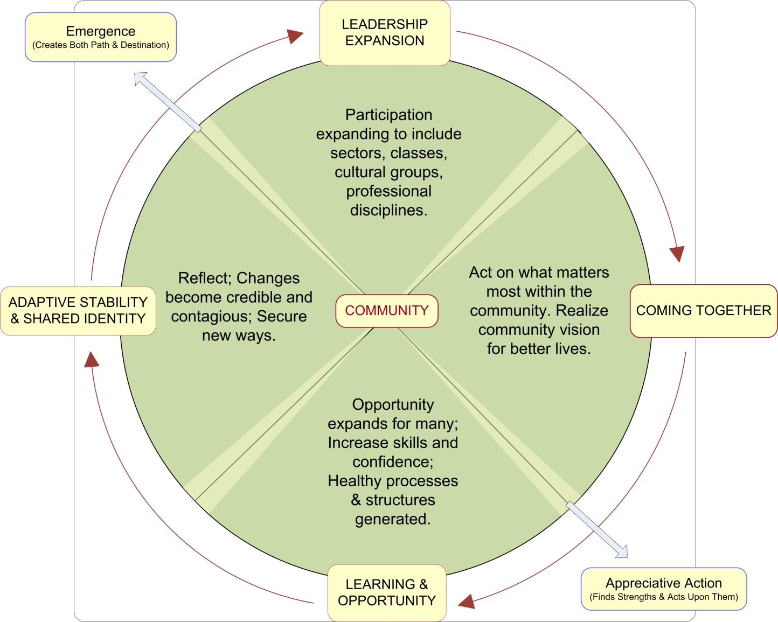
Notes:
Include real – life example of this working
Communities can be more or less resilient. They are impacted by the resilience of individual members – and they influence those members as well.
General Community Capacity Development is
a public health approach
to solving interrelated problems by improving:
Peoples’ connections,
Shared responsibility, and the
Collective impact of their efforts.
This model is powerful because success in one phase propels success in the next. It is a virtuous cycle that has the power to improve population health.

Slide 64
The Power of Community Capacity
on Depression and Serious Persistent Mental Illness Ages 18-34
High Capacity
High Capacity
High Capacity
Significant differences after controlling for age, education, income, race/ethnicity, and ACE score.
Longhi, D., Silveanu, A., & Porter, L. (2012, February 1). Stress, Strength, Work, Hope. Family Policy Council - Community Networks. Retrieved August 9, 2013, from www.fpc.wa.gov/publications/StressStrengthWorkHope.VR-Data-Report.pdf
Notes:
High Capacity
Snohomish
Pierce
Kitsap
Whatcom
Grant
Walla Walla
Okanogan
Adams
San Juan
Wahkiakum
Low Capacity
All others except King,
which was
excluded from study

Slide 65
The Power Of Community Capacity Better Outcomes Among 18-34 Year Olds
Hall, J.,Porter, L., Longhi, D., Becker-Green, J., Dreyfus, S. (2012) Reducing Adverse Childhood Experiences (ACE) by Building Community Capacity: A Summary of Washington Family Policy Council Research Findings. Journal of Prevention and Intervention in the Community 40: 325-334.

Slide 66

Risk is Usually Measured Here
We Increase Probability of Lasting Change When We Notice and Act Below the Waterline
Events
Patterns
Structures
Unseen
Mental Models
Values/Principles

Slide 67
What We Can Do ?
Tell everyone
Adopt trauma-informed services and supports
Shift to dual generation strategies
Invest in community capacity
Generate feedback
Hold a fundamental respect for the wisdom of every person—their culture, experience, capabilities, and aspirations

Slide 68
Thank you!
For follow-up please contact:
Marie Cox
Coordinator, CAPT Southwest RT
mariecox@ou.edu
405-255-2351

